Slide 1
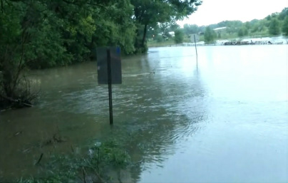
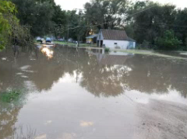
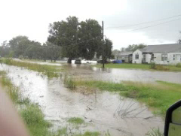
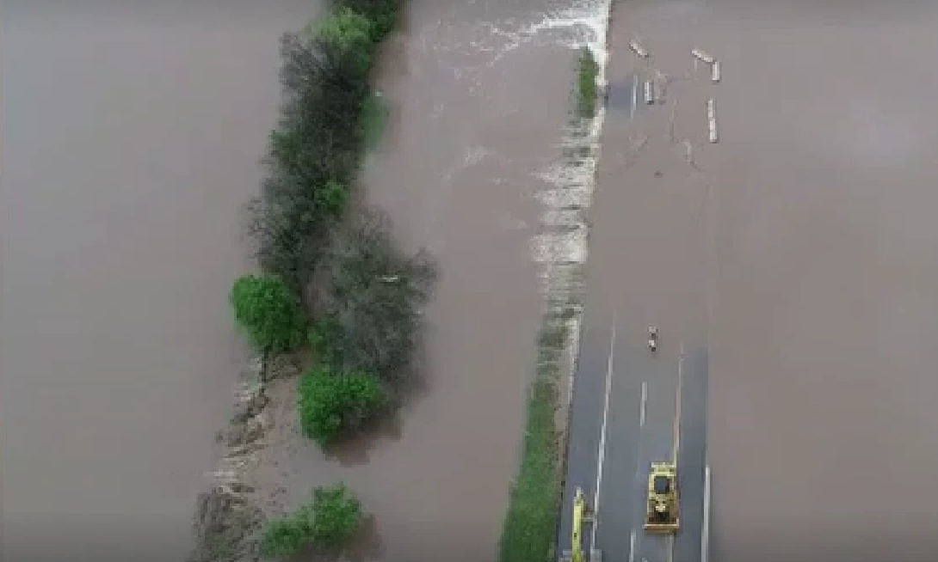
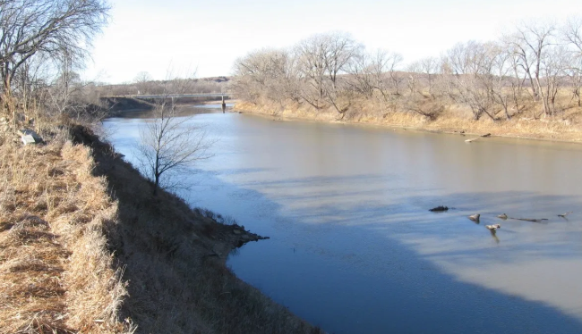
Sun City Technical Assistance
June 9th, 2020

Slide 2
Thank you for joining us today!
Your input is very important to this work.

Slide 3
Rules of the Road
Attendees will be muted during the presentation, to help eliminate background noise.
Check out the chat to ask questions during the presentation! Or feel free to “raise your hand.” We will pause for questions at various stopping points and and have several poll questions.
If you want to share your video, please do!
For technical difficulties: send a private chat to Joanna Rohlf; or email Joanna.Rohlf@ks.gov
We’ll be recording this webinar for those who aren’t able to attend today.
Notes:
Talking point: Given that we all have “co-workers” at home, pets, doorbells being rung, etc., we’ll just say up front that we understand! Hopefully these rules of the road will help minimize background noises somewhat, so we can focus on what we want to talk through today.

Slide 4
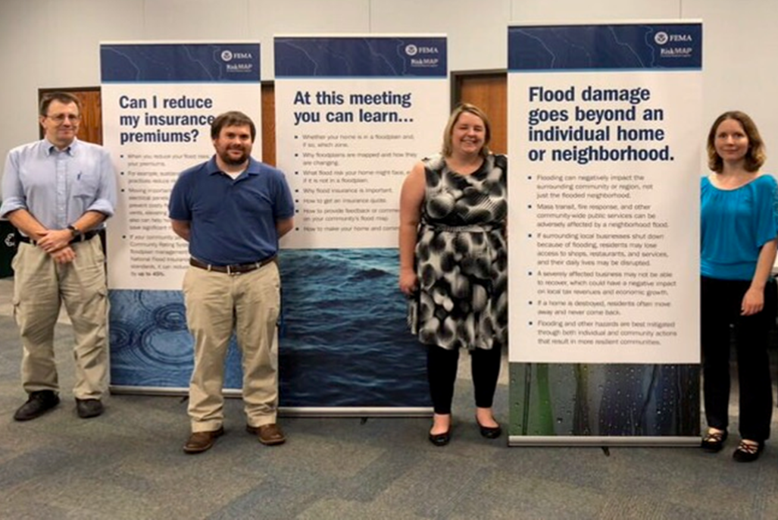
Intros
Kansas Department of Agriculture
Tara Lanzrath, CFM –
Floodplain Mapping Coordinator
Joanna Rohlf, CFM –
Floodplain Mapping Specialist
William Pace, CFM –
Floodplain Mapping Specialist
Steve Samuelson, CFM –
State NFIP Coordinator
AECOM Technical Services, Inc.
Brandon Banks – Project Manager
Zach Matteo– Engineer, P.E.
Hayden Edwards - Engineer

Slide 5
Over the past 30 years, flooding has been more dangerous in the U.S. than any other weather-related problem. To minimize flood damage, we have to first understand where the risk is.

Slide 6
Today’s Goals
Give an overview of the scope of the Technical Assistance project
Understand the current flooding problem
Collect relevant Data/Input from the community
Discuss possible mitigation scenarios to relieve flood risk
Discuss Final Products and Path Forward
OPEN DISCUSSION

Slide 7
Overview

Slide 8
Overview of Project Scope
To develop a series of engineering model runs to determine the best course of action to alleviate flooding within the city.
Possible flood mitigation scenarios could include levees, culvert improvements, channelization, detention ponds
Provide Sun City with the results of the engineering analyses and estimated design/build costs for each scenario.

Slide 9
Flood Risk Discussion

Slide 10
Current Flood Risk
Intersection of 1st Ave W and Elm St
Notes:
Talking point: How we understand it to be, encourage feedback about flood problems and if we are understanding the flood routing properly.

Slide 11
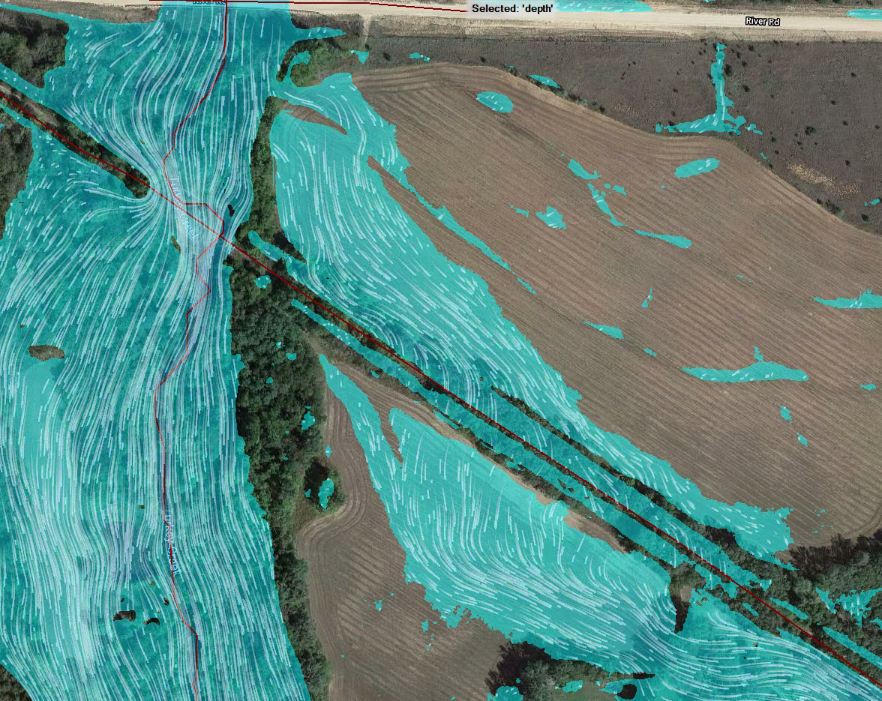
Current Flood Risk
Overflow from Turkey Creek runs along north and south side of railroad embankment
Notes:
Crosses railroad grade top elevation to south side of embankment

Slide 12
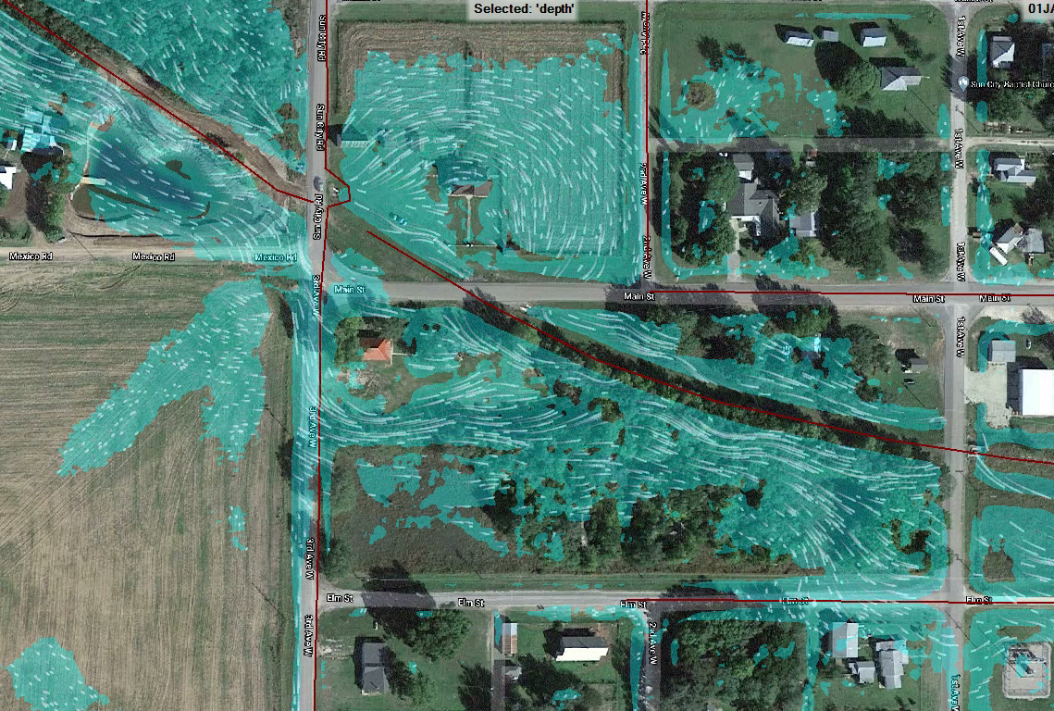
Current Flood Risk
Flow crosses Sun City Rd to and enters the city on both sides of Main St. Our model shows more flooding on between Main and Elm St.

Slide 13
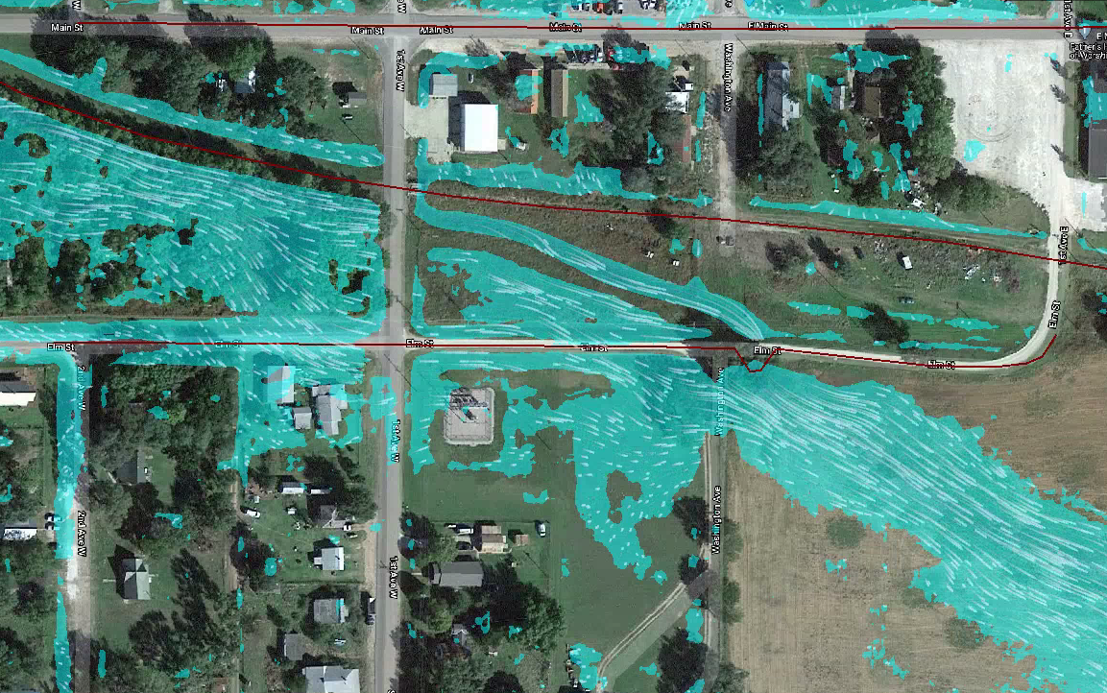
Current Flood Risk
Flow continues east over 1st Ave. and exits Sun City to the southeast eventually discharging into the Medicine Lodge River
25-year Flood Event

Slide 14
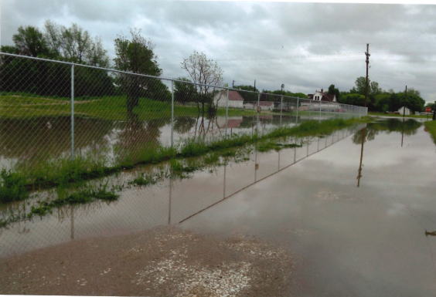
Current Flood Risk
Overflow of Pond along Mexico Rd
Notes:
Talking point: How we understand it to be, encourage feedback about flood problems and if we are understanding the flood routing properly.

Slide 15
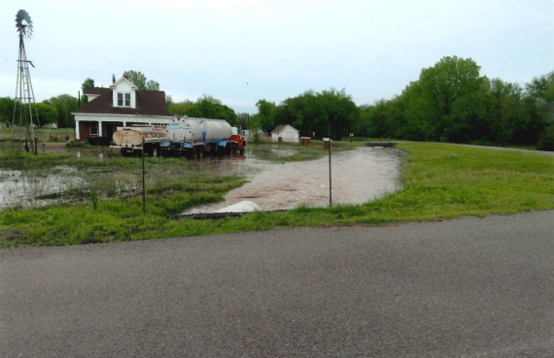
Current Flood Risk
View east of Sun City Rd

Slide 16
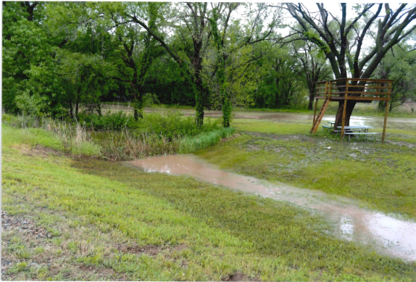
Current Flood Risk
Notes:
Left caption blank to ask where this picture is taken

Slide 17
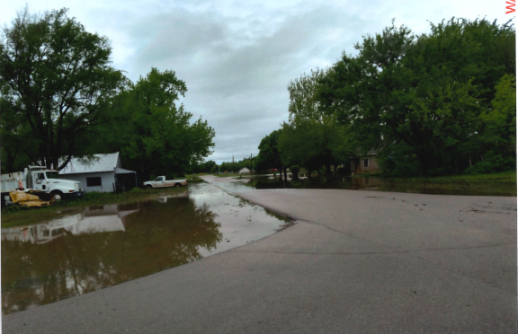
Current Flood Risk
Notes:
Left caption blank to ask where this picture is taken

Slide 18
Data Collection
Community Flood Concerns
Flooded Building Addresses
Affected Structures
Data about structures/culverts
Areas of Public/Private Land
Storm Event Information
Dates of Floods
Precipitation Amounts
Notes:
These are types of data we would like to know to help assist the community. We want to try our best to understand the magnitude of the recent floods they have experienced.

Slide 19
Flood Mitigation Discussion

Slide 20
Possible Flood Mitigation Actions
Preliminary ideas for flood mitigation in Sun City
Improve conveyance of flood through Sun City
Culvert/Channel Improvements
Detain water upstream of Sun City
Detention Basins
Levee along Turkey Creek to prevent spill over
Each idea could have several scenarios associated with it
Notes:
Each mitigation action listed could involve various scenarios. (Example: Improve conveyance with different sized culverts or channels)

Slide 21
Possible Flood Mitigation Actions
Improve Conveyance
Notes:
Relying on Discussion for these slides. Basic graphics highlighting area of possible improvements.

Slide 22
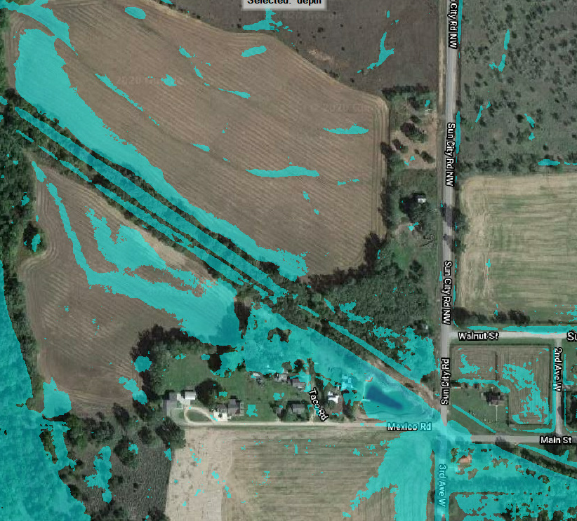
Possible Flood Mitigation Actions
Upstream Detention
Notes:
Relying on Discussion for these slides. Basic graphics highlighting area of possible improvements.

Slide 23
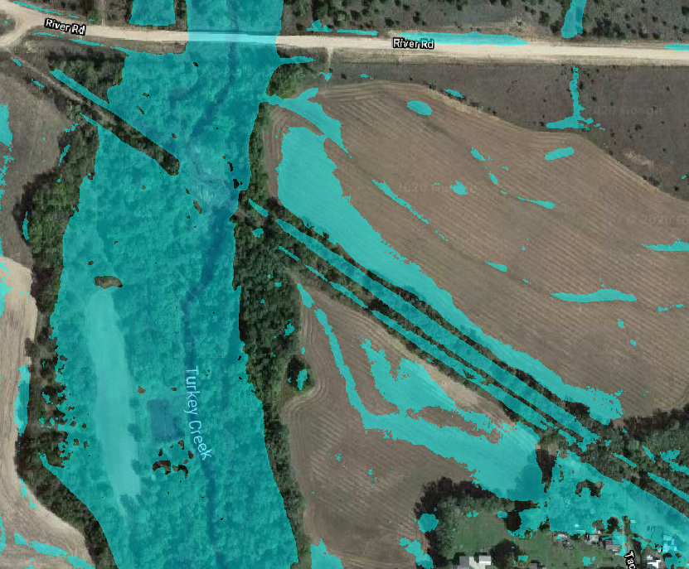
Possible Flood Mitigation Actions
LEVEE

Slide 24
Final Products
Goals and Your Role in the Process

Slide 25
Final Products
2D HEC-RAS models for each flood mitigation scenario. Leveraged from Lower Arkansas 2D BLE Study.
Results of the Water Surface Elevation, Depth, and Velocity of each flood scenario
Mapping exhibit for each flood scenario
Report outlining engineering methods, results, and estimate design/build costs

Slide 26
Goals
Identify Flood Risk
Develop Possible Solutions
Utilize Analyses to determine best path forward
End Goal: Protect Sun City from dangerous and damaging floods

Slide 27
Path Forward
Reconvene with Community of Sun City, KDA, and AECOM in September
Utilize engineering study to determine the best plan of action for Sun City
Apply for Grants

Slide 28
KDA - Contact Information
Tara Lanzrath, CFM – Tara.Lanzrath@ks.gov
D: 785-296-2513 M: 785-276-9359
Floodplain Mapping Coordinator
Joanna Rohlf, CFM –
Joanna.Rohlf@ks.gov
D: 785-296-7769
Floodplain Mapping Specialist
William Pace, CFM –
William.Pace@ks.gov
D: 785-296-5440
Floodplain Mapping Specialist
Steve Samuelson, CFM –
Steve.Samuelson@ks.gov
D: 785-296-4622 M: 785-221-3809
State NFIP Coordinator

Slide 29
AECOM - Contact Information
Brandon Banks-
Brandon.Banks@aecom.com
O: 816-410-6373
Project Manager
Hayden Edwards -
Hayden.Edwards@aecom.com
O: 816-360-4638
Engineer
Zach Matteo-
Zach.Matteo@aecom.com
O: 816-410-6364
Engineer, P.E.

