Slide 1
2018 KACD Fall Workshop
DOC Report

Slide 2
State Water Plan Budget
 | DOC Programs | FY 2018 Approved | FY 2019 Adjusted | FY 2020 Proposed
 | Conservation District Aid | $2,000,000 | $2,092,637 | $2,092,637
 | Water Resources Cost-Share | $1,727,387 | $1,948,289 | $1,948,289
 | Non-Point Pollution Cost-Share | $1,502,909 | $1,860,023 | $1,860,023
 | Watershed Dam Construction | $511,076 | $550,000 | $550,000
 | Water Supply Restoration / MSL | $0 | $0 | $0
 | CREP / WTAP | $177,141 | $201,963 | $200,000
 | Water Quality Buffer Initiative | $88,662 | $200,000 | $200,000
 | Riparian & Wetland | $416,655 | $154,024 | $154,024
 | Irrigation Technology* |  | $100,000 | *$100,000
 | Streambank Stabilization* |  | $500,000 | *$500,000
 | TOTAL | $6,423,830 | $7,606,936 | $7,604,973

Slide 3
Sediment and Nutrient Reduction Initiative
Replaces the current Water Quality Buffer Initiative Program
Legislature allocated $281,312
Incentive payment on new CRP enrollments for the following practices:
Grassed Waterways, Shallow Water Areas for Wildlife, Filter Strips, Riparian Buffers, Wetland Restorations, Improvements to Farmable Wetland, Bottomland Hardwood Timber Establishment, and Habitat Buffers for Upland Birds

Slide 4
Sediment and Nutrient Reduction Initiative (cont.)
Priority HUC 12’s in the Milford Lake watershed will be targeted initially
Following counties have priority HUC 12’s in the Milford Lake watershed:
Clay, Cloud, Dickinson, Geary, Republic, Riley, and Washington

Slide 5
Sediment and Nutrient Reduction Initiative (cont.)
Future program expansion includes the following watersheds:
Big Creek, Delaware, Little Arkansas, Lower Big Blue, Lower Kansas, Lower Little Blue, Lower Republican, Lower Smoky Hill, Neosho, Upper Cottonwood and Lower Cottonwood watersheds
Reservoirs affected by future program expansion:
Tuttle Creek, Perry, John Redmond, and Clinton reservoirs

Slide 6
Sediment and Nutrient Reduction Initiative (cont.)
Program eligible areas shall contain 2 tiers for priority enrollment
Tier 1 areas – HUC 12 watersheds identified in watershed restoration and protection strategy plans as the highest priority target areas
Tier 2 areas – All areas within the program eligible boundaries that are not tier 1 areas
One time incentive payment
$225 per acre in Tier 1 areas
$162.50 per acre in Tier 2 areas

Slide 7
Riparian Quality Enhancement Initiative
Program funded trough the Riparian and Wetland Program
Goal of the initiative is to reduce livestock contact with surface water. Seeking to fund projects with the highest riparian area protection benefits.
Program is currently being developed.

Slide 8
Soil Health Education Funds
Funds are available in FY 2019
Soil health workshops and field days
Educational materials, cover crop seed etc.
Cover Crop and Grazing Management
$2,500 limit per application for workshop
No-till on the Plains Winter Conference registration fees
CD Supervisors
Landowner/operator first time attendees
CD employees

Slide 9
CSIMS 2.0 Upgrade
Rollout anticipated in late fall
Training Opportunities for District Managers:
DOC Webinars – TBD
KACD Convention – November, 2018

Slide 10
Kansas Reservoir Protection Initiative
FY 2019 State Water Plan Funds to the Kansas Water Office (2018 Kansas Legislature provided additional funding to the State Water Plan)
KWO, KDHE, KDA/DOC and RAC’s involved in program development
Payment rate of $50 per ton of sediment reduced by approved practices
FY 2019 program budget of $900,000
Applications submitted by Conservation Districts
Contracts and Payments through CSIMS

Slide 11
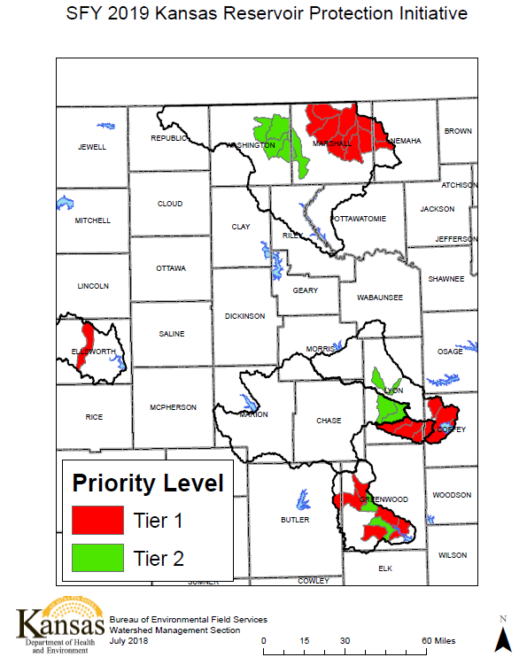

Slide 12
Livestock Water Supply Financial Assistance Initiative
Eligible areas are the same as the 2018 NRCS EQIP Drought Initiative
Livestock wells, pipeline, tanks and pumps are eligible
50% cost share rate, $6,000 landowner limit
Practices installed from June 1st, 2018 through July 24th, 2018
Applications accepted until August 31st, 2018

Slide 13
Supervisor Training & Recognition Program
16 training modules to teach supervisors the basic operations of a CD
14 modules developed by DOC - www.agriculture.ks.gov/
2 modules developed by KACD - www.kacdnet.org/
Complete all 16 training modules
Send completed signed and certified KS CD Supervisors Training and Recognition Program Completion Report to DOC no later than November 10th
Supervisors will be presented a leather portfolio at the KACD Convention

Slide 14
AgriLand at State Fair Pride of Kansas Building
DOC sent email to CD’s on July 2nd looking for volunteers to help staff the soil tunnel trailer / AgriLand exhibit at Kansas State Fair
Use hyperlink to access spreadsheet for sign up
Shifts 9-3 and 3-9
1-2 per shift except on weekends and Dollar Days, September 10th

Slide 15
FY 2019 Cost-Share Cancellation/Reallocation Policy
Cancellation of Uncommitted WR and NPS Funds
December 7, 2018
Reallocation of Uncommitted funds
Priorities to be determined by the SCC

Slide 16
Reminders
2019 Annual Work Plan – due September 1, 2018
Documents activities to be completed during fiscal year
Email an electronic copy to DOC at kda.doc@ks.gov
2019 Budget – due September 1, 2018
Mail the Operations and Enterprise Fund Budget with original signatures to the DOC after certification by County Commissioners and final CD Board has reviewed and signed
2018 Financial Management Checklist – due Sept. 1, 2018
Mail the checklist to the DOC after CD Board has reviewed and signed

Slide 17
Reminders
Riparian & Wetland Program
Has dedicated funding available for wetland and wetland-related projects
Contact Tim McCoy with the DOC for assistance if your county has a potential wetland project

Slide 18
Questions

