Slide 1
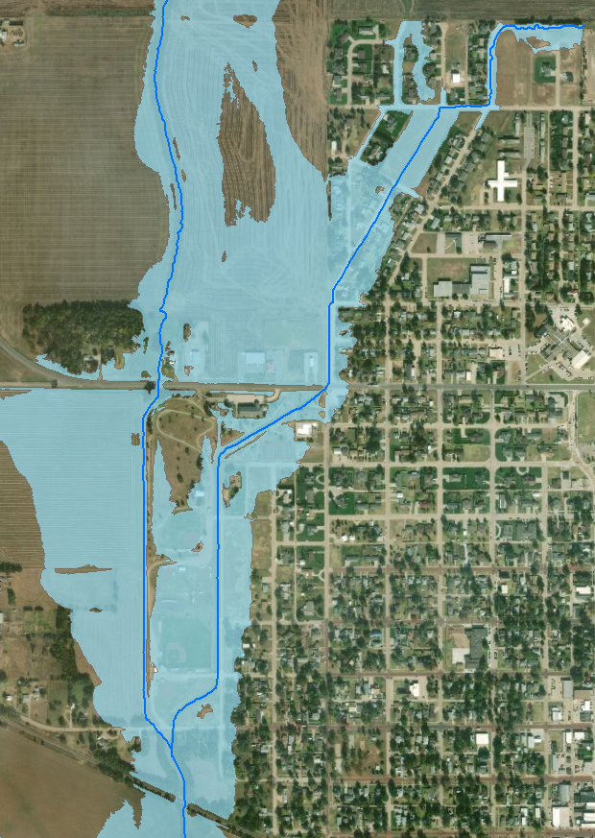
Hoisington Technical Assistance
January 30, 2019

Slide 2
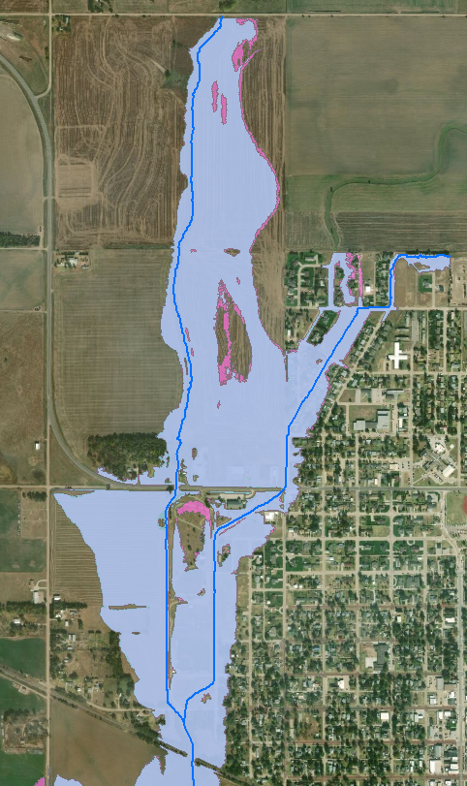
100yr Floodplain with Updated Modeling

Slide 3
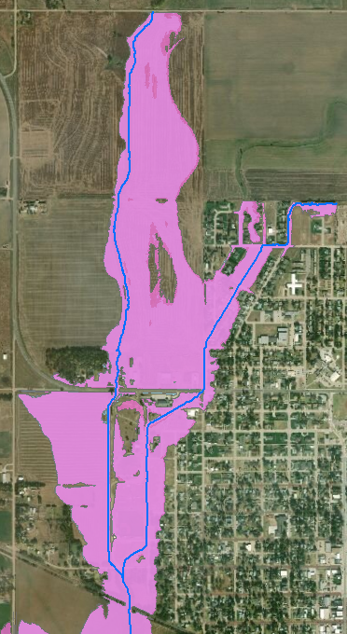
100yr Floodplain with Updated Modeling

Slide 4
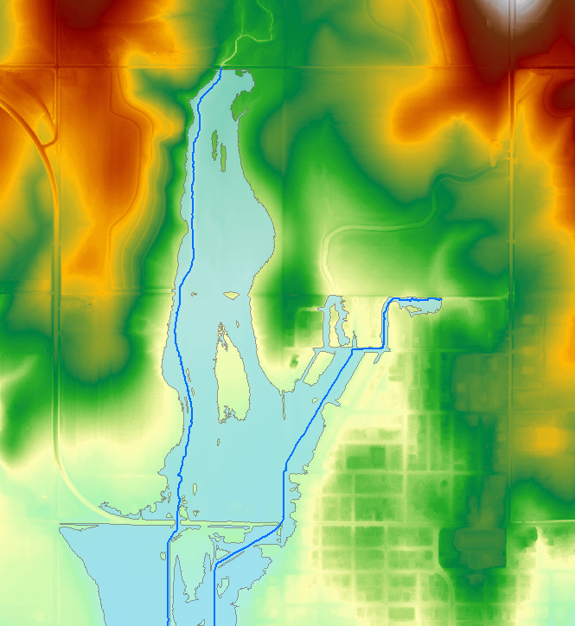
Flooding Sources
Shop Creek Drainage
Shop Creek Tributary Drainage from North
Shop Creek Tributary Drainage from East

Slide 5
Alternatives Modeled per Project Plan
Shop Creek Detention Dam North of NE 120th Street
Positive impact to Shop Creek flooding
Shop Creek and Shop Creek Tributary Sediment Removal
Good Maintenance Item
Minimal impact on 100yr floodplain
Shop Creek Tributary Diversion Channel to Shop Creek
Positive impact when combined with other alternatives
Shop Creek Tributary Detention Dam North of N Center Street
Positive impact to most of Shop Creek Tributary flooding

Slide 6
Alternatives Modeled per Project Plan
Shop Creek Channel Improvements North of K-4 Highway, with enlargement of Road Opening
Positive impact when combined with other alternatives
Shop Creek Tributary Channel Improvements North of K-4 Highway, with enlargement of Road Opening
Positive impact when combined with other alternatives
Shop Creek Channel Improvements between West 2nd Street and K-4 Highway, with enlargement of Road Opening
Positive impact when combined with other alternatives

Slide 7
Alternatives Modeled per Project Plan
Shop Creek Tributary Channel Improvements between West 2nd Street and K-4 Highway, with enlargement of Road Opening
Minimal impact on 100yr floodplain
Shop Creek Detention Dam approximately ½ mile north of K-4 Highway
Positive impact to Shop Creek flooding
Shop Creek Tributary Detention Enlargement and Lift Station
Reasonably sized structure produced minimal impact on 100yr floodplain

Slide 8
Additional Alternatives Modeled
Enlargement of Long Culvert along Shop Creek Tributary
Positive impact when combined with other alternatives
Fill Pad North of Shop Creek Tributary
Positive impact when combined with other alternatives
Enlargement of Railroad Opening
Positive impact to specific flooding area.
Drainage Channel at upstream end of Shop Creek Tributary
Positive impact to specific flooding area.
Drainage Channel for Shop Creek overflow north of K-4 Highway
Positive impact to specific flooding area.

Slide 9
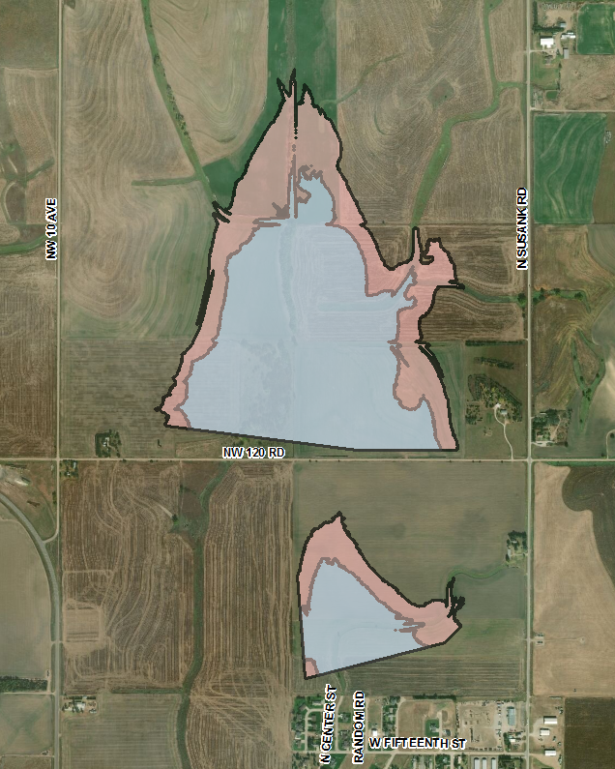
Option 1A
Dam A and Dam C

Slide 10
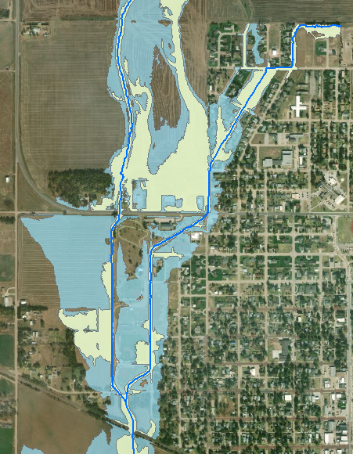
Option 1A
Dam A and Dam C

Slide 11
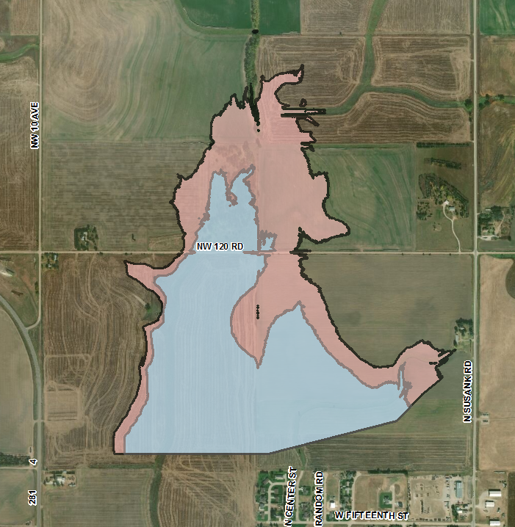
Option 1B
Dam B and Dam C

Slide 12
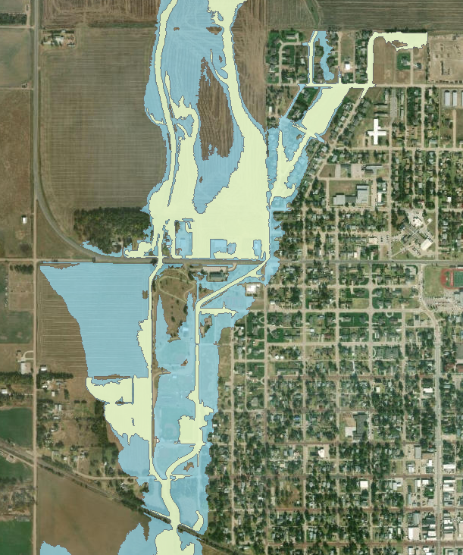
Option 1B
Dam B and Dam C

Slide 13
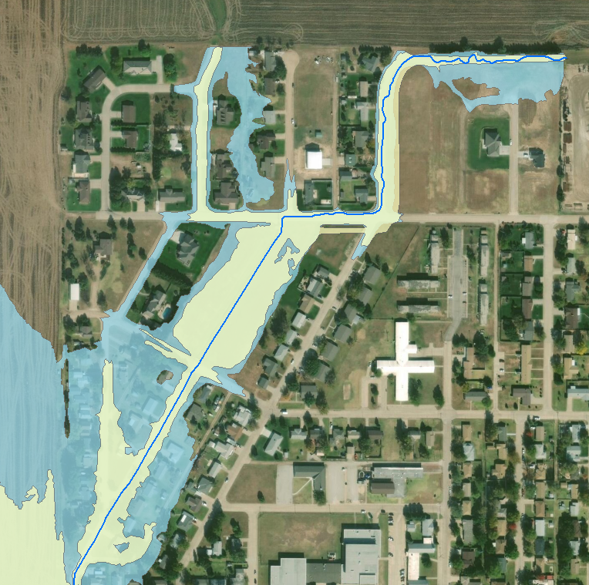
Option 1A or 1B
With new NE Drainage Channel

Slide 14
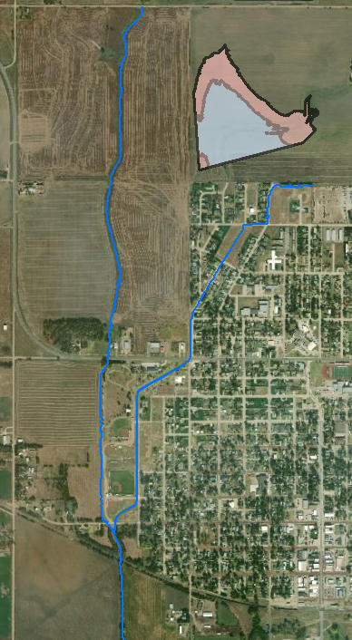
Option 2
Channel Improvements to Shop Creek
Dam C

Slide 15
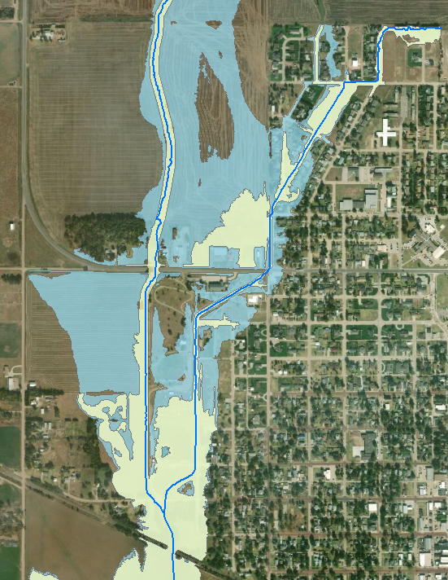
Option 2
Channel Improvements to Shop Creek
Dam C

Slide 16
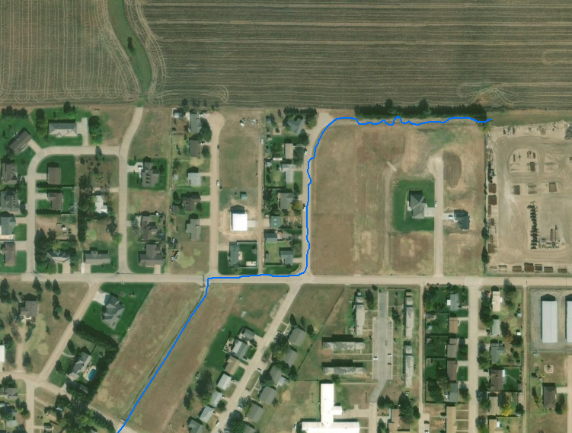
Option 2
With new NE Drainage Channel

Slide 17
Option 2
With new NE Drainage Channel

Slide 18
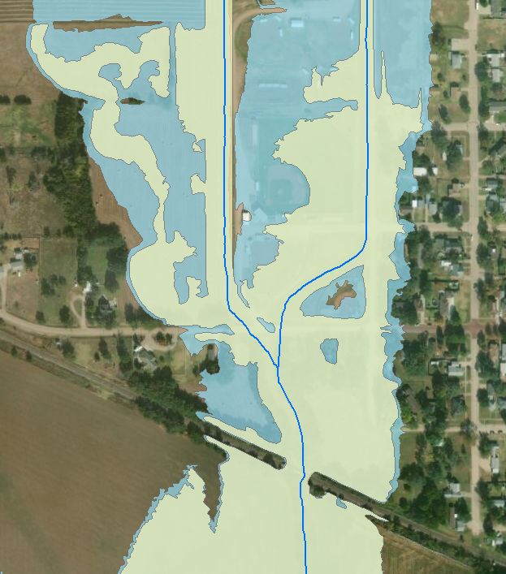
Option 2
With Railroad Opening Enlargement

Slide 19
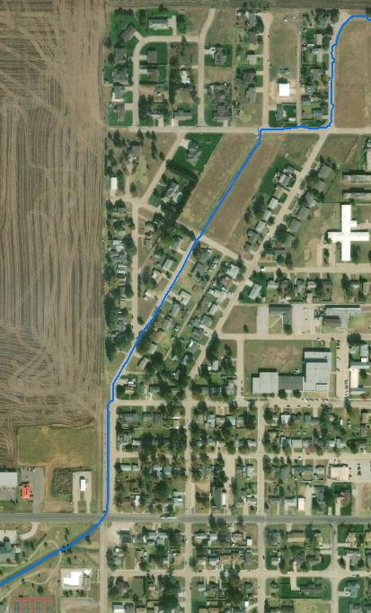
Option 3
Dam A/B
Channel Improvements to Shop Creek Trib
Long Culvert Enlargement

Slide 20
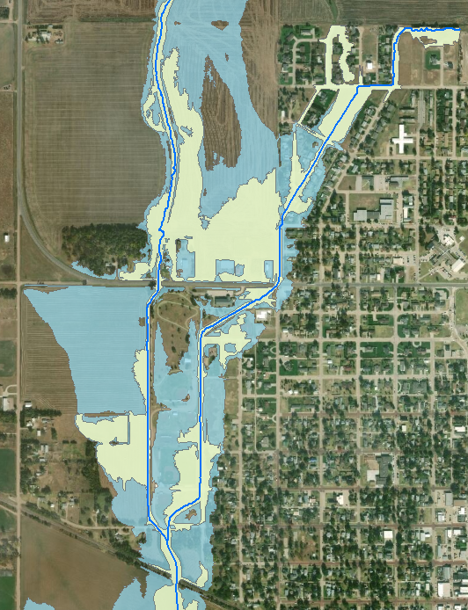
Option 3
Dam A/B
Channel Improvements to Shop Creek Trib
Long Culvert Enlargement

Slide 21
Option 3
With new NE Drainage Channel

Slide 22
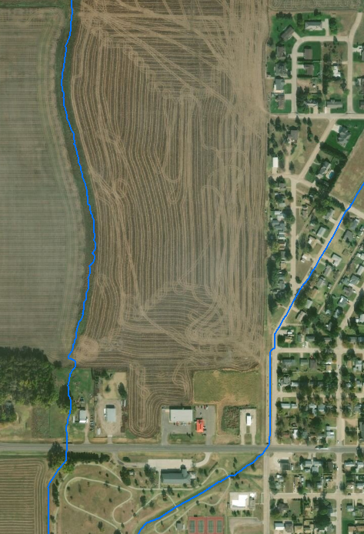
Option 3
With Shop Creek Improvements

Slide 23
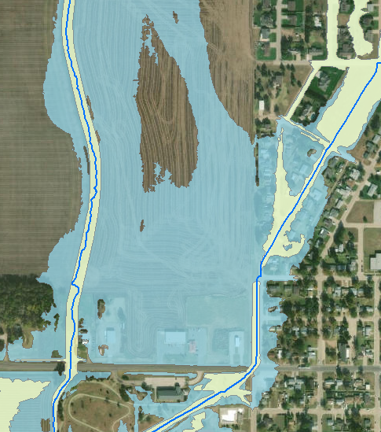
Option 3
With Shop Creek Improvements

Slide 24
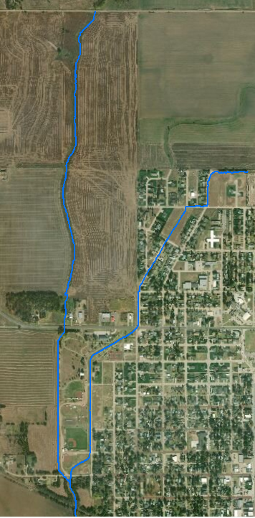
Option 4
Channel Improvements to Shop Creek
Channel Improvements to Shop Creek Trib
Long Culvert Enlargement

Slide 25
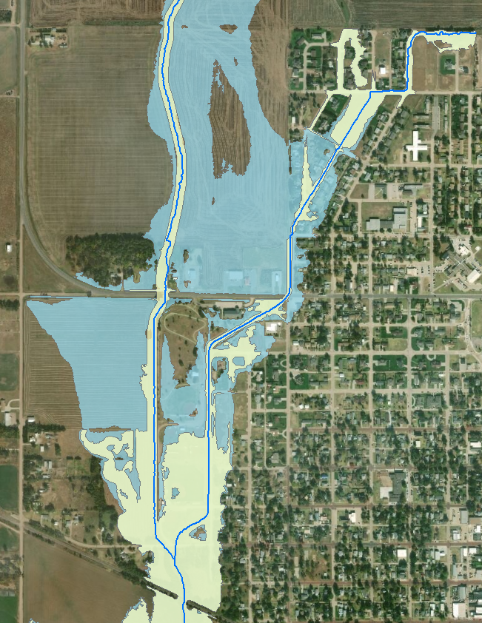
Option 4
Channel Improvements to Shop Creek
Channel Improvements to Shop Creek Trib
Long Culvert Enlargement

Slide 26
Option 4
With new NE Drainage Channel

Slide 27
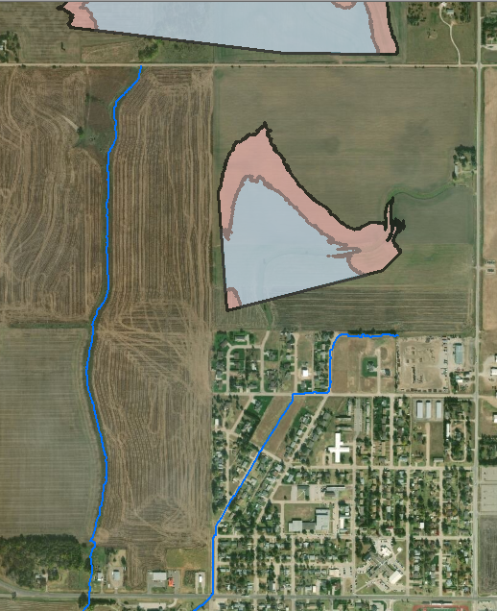
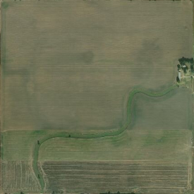
Option 5
Dam A
Fill and Diversion Channel N of Shop Creek Trib
NE Drainage Channel
Area of Fill

Slide 28
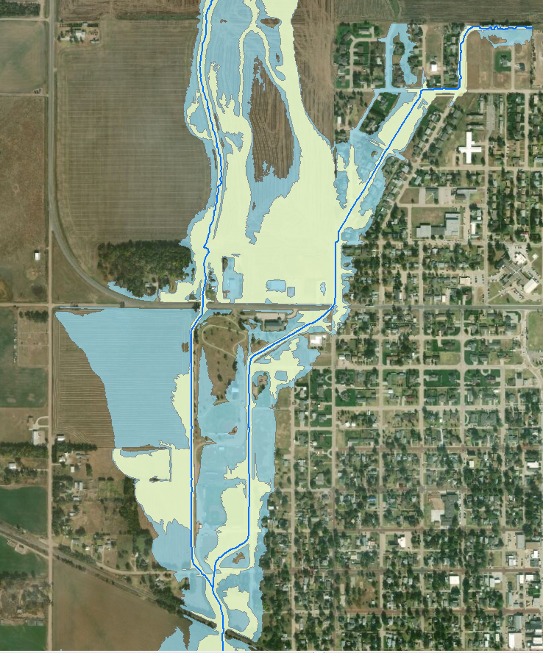
Option 5
Dam A
Fill and Diversion Channel N of Shop Creek Trib
NE Drainage Channel

Slide 29
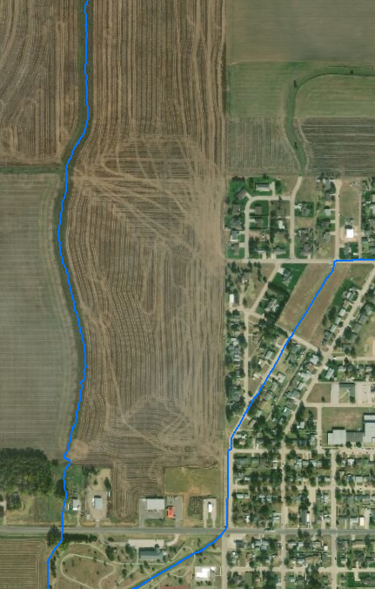
Option 5
With new Drainage Channel for Shop Creek Overflow

Slide 30
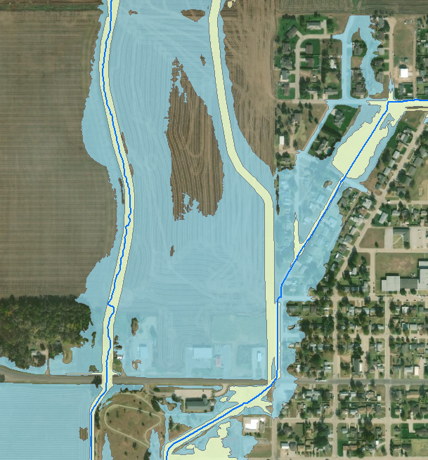
Option 5
With new Drainage Channel for Shop Creek Overflow

Slide 31
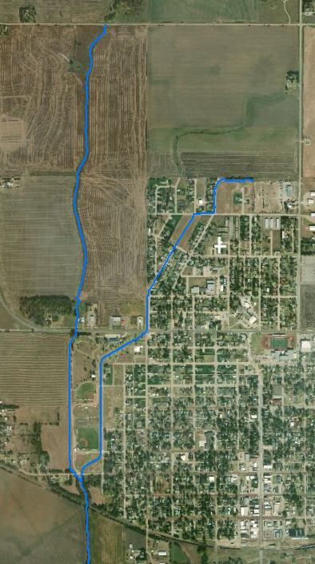
Option 6
Area of Fill
Channel Improvements to Shop Creek
Fill and Diversion Channel N of Shop Creek Trib
NE Drainage Channel

Slide 32
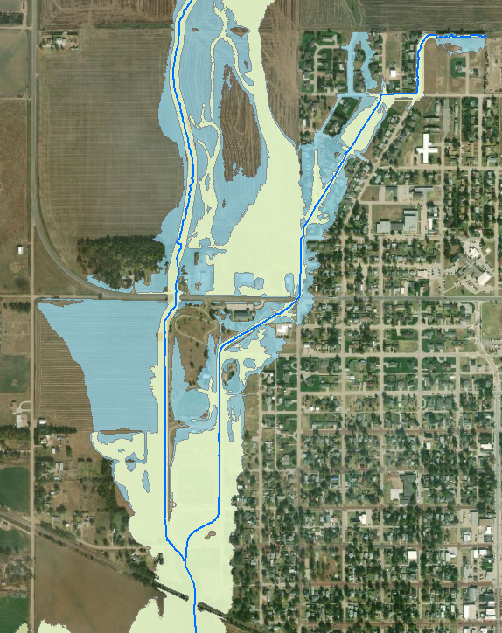
Option 6
Channel Improvements to Shop Creek
Fill and Diversion Channel N of Shop Creek Trib
NE Drainage Channel

Slide 33
Option 6
With new Drainage Channel for Shop Creek Overflow

Slide 34
Next Steps
Get Community Buy-In
Evaluate Additional Options Discussed Today
Create Concept Descriptions
Create Project Cost Estimates
Report and Recommendations

Slide 35
Questions?
Joe File Maria Neeland
Wood E&IS Wood E&IS
joe.file@woodplc.com maria.neeland@woodplc.com
785-554-9108 785-410-7499
Tara Lanzrath Joanna Rohlf
KDA-DWR KDA-DWR
tara.lanzrath@ks.gov joanna.rohlf@ks.gov
785-296-2513 785-296-7769

