Slide 1
NRCS Report 2017 SCC Spring Workshop
Notes:
Thank you for inviting me to the SCC workshop. In the next 15 minutes I’ll give an update on NRCS activities and then allow some time for questions.
Let’s go to the topics slide.

Slide 2
Topics
Budget Status for Fiscal Year 2017
Kansas NRCS Staffing Outlook
Program Updates
Emergency Watershed Program (EWP)
Notes:
These are the topics I’ll cover today. First, a short update on our current year budget status and a perspective on the impact of the hiring freeze, and then highlight 2017 funding updates and status of our programs.
I’ll wrap-up with a foot-stomp for the Emergency Watershed Program. It’s a program for local officials to use when a local disaster strikes due to a natural event, such as a flood. This year we have 17 projects in the works due to flooding and tornados.
Let’s get started with the 2017 budget outlook. Next slide.

Slide 3
Budget Status for Fiscal Year 2017
Mandatory Funds (Farm Bill) will be adequate for Fiscal Year.
Discretionary Funds (includes CTA) are authorized through April 28, 2017, due to Continuing Resolution.
Current projections are that Discretionary Funds will be adequate for Fiscal Year.
New agreement review policy.
Notes:
This slide summarizes what we know right now about our budget. For the Farm Bill programs, we have sufficient funding to get the work completed.
The Discretionary Funding (which predominately consists of the Conservation Technical Assistance program) is still a bit uncertain since we are under a Continuing Resolution through April 28, 2017.
However, funding projections at this time appear that we will have adequate funding to meet our mission needs – especially due to the current hiring freeze in place.
The new administration implemented an order that all agreements must be reviewed by the Department before being approved. I am not sure how long this requirement will be in place. It does extend the length of time required to get an agreement approved.
On the next slide, I’ll share where our staffing stands and what we know about the hiring freeze.

Slide 4
Kansas NRCS Staffing Outlook
President Trump issued 90 day hiring freeze beginning in January.
Kansas NRCS had 36 positions in the HR process when the freeze hit.
Also have 12 student trainee positions to fill.
Pathways student training program is NOT affected by the freeze.
Notes:
The hiring freeze had been telegraphed before the new administration transitioned, so this was not a surprise when the freeze became official on January 23rd.
I am optimistic that we can move forward after the freeze expires with the 36 positions that where in the pipeline.
We will just have to see how the policy unfolds as we approach the 90 day mark. Conservation efforts have a great deal of support, so I’m optimistic.
There is good news about the pathways student training program---It is NOT affected by the freeze, so we look to having these students in the field by the summer.

Slide 5
2017 EQIP Financial Assistance Summary
Program Area | Funds
Ranking Category Funding | $19,864,000
State Reserve | $300,000
Special Initiatives | $5,230,000
Total 2017 EQIP | $25,094,000
For FY2016 we had $15M worth of eligible applications that went unfunded!
Notes:
Our total EQIP funding this year is a little over 25 million dollars. The general EQIP funding is almost 20 million, with special initiatives funding at over 5 million.
For fiscal year 2016, we had 15 million dollars worth of eligible applications that went unfunded. We have a great deal more demand than we have funding for EQIP.
We can expect a similar situation this year, where we have many more applications than what we can fund.
The next slide shows how the general EQIP funding is broken out.

Slide 6
2017 General EQIP Breakout
Categories | % | Funds
Forestland Health | 1.0% | 198,640
Grazing Lands Health | 19.0% | $3,774,160
Livestock Waste | 20.0% | $3,972,800
Sedimentation Above Federal Reservoirs | 5.0% | $993,200
Soil Health | 10.0% | $1,986,400
Tribal | 0.5% | $99,320
Water Quality | 18.0% | $3,575,520
Water Quantity | 11.5% | $2,284,360
Wildlife Habitat | 5.0% | $993,200
Beginning Farmer/Rancher | 5.0% | $993,200
Socially Disadvantaged Farmer/Rancher | 5.0% | $993,200
Total 2017 Ranking General EQIP Allocations |  | $19,864,000
Notes:
This slide shows general EQIP funding by category. Several eligibility and ranking criteria have been updated based on the Kansas Technical Committee’s recommendations.
Total general EQIP is almost 20 million dollars. Moving to the next slide, it shows the breakout of the 2017 special EQIP initiatives.

Slide 7
2017 EQIP Initiative Breakout
Program Area | Funds
Conservation Innovation Grants | $200,000
National On-Farm Energy Initiative | $100,000
National Organic Initiative | $50,000
National High-Tunnel System Initiative | $300,000
National Water Quality Initiative | $683,000
Lesser Prairie-Chicken Initiative | $1,897,000
Monarch Butterfly Habitat Initiative | $100,000
Ogallala Aquifer Initiative | $1,100,000
Anderson Creek Wildfire Initiative | $500,000
2017 EQIP Special Initiative Funding | $5,230,000
Notes:
Special EQIP initiatives can be national in scope, or local. This year, Kansas NRCS created a special EQIP for farmers and ranchers impacted by the Anderson Creek wildfire in response to the Barber County’s request. We have allocated 500 thousand dollars each year for the next 4 years – a total of 2 million.
Another local special EQIP is the Conservation Innovation Grant for 200 thousand. This is a program that leverages the resources of partners and state agencies.
We’ve also funded the Lesser Prairie Chicken Initiative for almost 2 million. This is a big push. We are reaching out to our partners and producers for help so that we can increase the bird’s habitat.
Applications closed for the Conservation Stewardship Program in February. The next slide illustrates the current status for CSP.

Slide 8
Conservation Stewardship Program (CSP)
For 2017 CSP
248 Renewal Contracts
$5.7M for 620,000 contract acres
467 General Applications
281,063 acres allocated to Kansas
Will be very competitive
Notes:
For 2017, CSP had 248 renewal contracts for 620,000 acres.
Then we have 467 general applications against an allocation of a little over 280 thousand acres. The Conservation Stewardship Program remains very competitive.
Next, a short update on the Regional Conservation Partner Program.

Slide 9
RCPP
Monarch Butterfly Project, multi-state agreement with the National Fish & Wildlife Foundation
Texas is the NRCS lead state
Notes:
The Monarch Butterfly Project is a multi-state agreement with the National Fish & Wildlife Foundation to improve Monarch Butterfly Habitat in 9 states.
Texas is the lead state for NRCS. Kansas can expect Financial Assistance over the agreement period in the amount of approximately $161,000 in CSP and $227,000 in EQIP.
Presenter note about states if asked:
States: Texas, Oklahoma, Kansas, Missouri, Illinois, Indiana, Iowa, Wisconsin, and Minnesota. Ohio is in the emphasis area but not part of this program.

Slide 10
RCPP
Native Grasslands Protection Project
Multi-state agreement with The Nature Conservancy
Kansas is the NRCS lead state
Notes:
The Native Grasslands Protection Project is a multi-state agreement with The Nature Conservancy to improve and restore native grassland habitat in Kansas and Oklahoma. Kansas is the lead state for NRCS.
Financial Assistance over the agreement period is approximately $1.8 million in EQIP and $1.8 million in ACEP.
Cut-off for applications is April 21st.

Slide 11
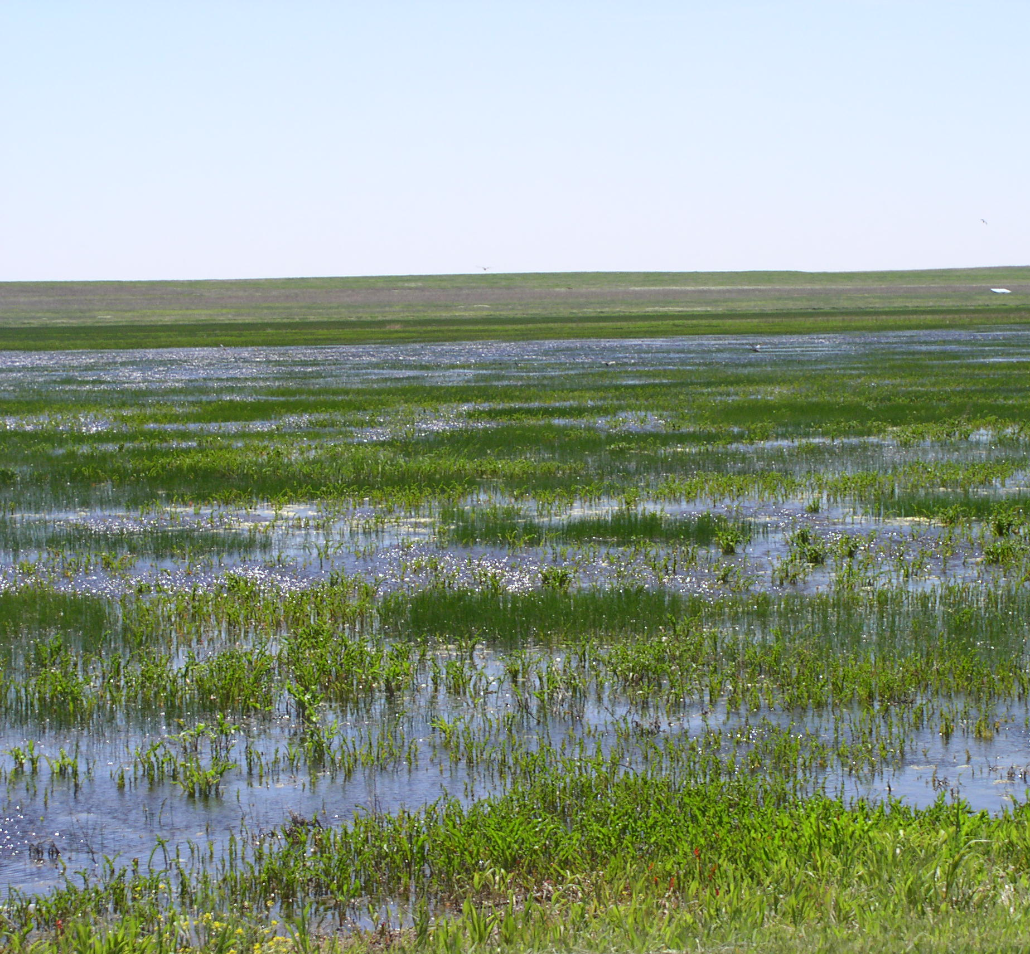
FY 2017 RCPP Proposals
1 state proposal submitted and approved.
Ducks Unlimited is the sponsor.
Purpose is to increase enrollment in the ACEP-WRE program.
Notes:
Kansas had 1 Regional Conservation Partnership Program proposal submitted and selected for funding in FY-17.
The Kansas Wetland Easements project is sponsored by Ducks Unlimited.
The primary purpose of the project is to increase landowner participation in the Wetland Reserve Easement program.
Ducks Unlimited and their partners will provide technical assistance to landowners interested in the WRE program by providing them information about the program, assisting submitting an application, and developing a wetland restoration plan. The project is statewide however an emphasis will be placed on the playa region in western Kansas.
The next slide is an update on Agricultural Conservation Easement Program

Slide 12
Agricultural Conservation Easement Program (ACEP)
For FY2017
39 applications for Wetland Reserve Easement (WRE)
No applications for Agricultural Land Easements
Highest Number of WRE Applications in 10 Years
Notes:
ACEP has two components: Wetland Reserve Easements and Agricultural Land Easements.
For fiscal year 2017, Kansas received 39 applications on over 2,500 acres for Wetland Reserve Easements . This is highest number of applications for wetland easements in over 10 years.
We are working these applications to determine which ones will receive offers for FY2017. We have close to $6 million in funds allocation to make offers to landowners. Each offer that is made is to include the easement purchase amount as well as the cost for the restoration of the wetland easement area.
No applications were received this fiscal year for Agricultural Lands Easements through the general ACEP application process. There are a couple of reasons why we didn’t have any. One reason is many Kansas land trusts haven’t had the funding match to purchase easements.
Another reason is that with some of our RCPP partnerships, the partner is acquiring easements through RCPP funding. Our RCPP partnership with The Nature Conversancy is an example where the partner is acquiring easements using funds set aside through RCPP.

Slide 13
Watershed Rehabilitation Program
Completed 7 new dam assessments.
4 of 5 dams continue in the rehabilitation planning process.
Rehabilitation to add water supply is now authorized.
Notes:
NRCS received funding to complete assessments on 7 dams in FY-16. We started the assessments last fall. They have been completed, so we are now distributing copies to the Watershed Districts and other local sponsors.
In addition, NRCS continues to work with watershed districts in Butler County to complete rehabilitation planning on 4 of 5 project dams.
For the 5th project, removing a house in the Breach Inundation Area took away the dam’s High Hazard Classification and the need to rehab the dam.
For the remaining projects, federal rehabilitation alternatives selected during the planning phase will allow NRCS to pursue funding for design and construction if requested by the Watershed Districts.
Adding new water supply is now an eligible purpose for rehabilitation funding on a case by case basis.
We have an number of active projects this year under the Emergency Watershed Program. The next few slides describe the program, the list of projects and finally some pictures of the damage and repairs being done in the affected counties.

Slide 14
Emergency Watershed Protection Program (EWP)
7 projects, involving 15 sites
Totaling about $2M
Important deadlines to keep in mind
Need to apply for assistance within 60 days of the disaster
Exigency projects–completion within 10 days
Non-exigency projects–completion within 220 days
Largest project workload since 2009
Notes:
Kansas NRCS is actively providing financial and technical assistance to the largest EWP project workload since 2009.
Currently we have 7 projects involving 15 sites that have received funding assistance that totals just over $2 Million.
The Emergency Watershed Protection programs assists project sponsors with implementing emergency recovery measures that relieve imminent hazards to life or property created by a natural disaster that caused a sudden impairment of a watershed.
Sponsors for these projects are counties, townships and watershed districts that have requested assistance with streambank damages, tornado debris removal, and watershed flood control damages from the natural disaster events in 2016.
Assistance requests need to be submitted within 60 days of the disaster event. Funded projects are either Exigencies that require treatment immediately within 10 days, or are Non-exigencies which allows up to 220 days to implement.
The next slide lists the EWP projects recently completed or in-progress.

Slide 15
EWP Projects Completed or In-Progress
County | Type | Description | Status | Amt. Funded (local/ state/Fed)
Doniphan | Exigency | Streambank stabilization | Comp. DEC 2017 | $28,009 (actual)
Brown | Exigency | Streambank stabilization | Comp. FEB 2017 | $245,270 (actual)
Dickinson | Non-Exig | Tornado debris removal | 9-sites under construction | $1,103,000
Marion | Non-Exig | Streambank stabilization | Design comp., out for bid | $554,000
Wabaunsee Township | Non-Exig | Streambank stabilization | Design near completion | $78,350
Greenwood | Non-Exig | PL-566 Watershed 12-3 auxiliary spillway repair | Recently funded, design pending | $9,000
Doniphan | Non-Exig | Streambank stabilization, site #2 | Recently funded, design pending | $54,040
Total Spent / Funded 17 Projects |  |  |  | $2,071,669
Notes:
This table illustrates the 7 approved projects from 2016 storm events, along with a brief description, current status and funding level.
My last couple of slides show some of the damage in these counties.

Slide 16
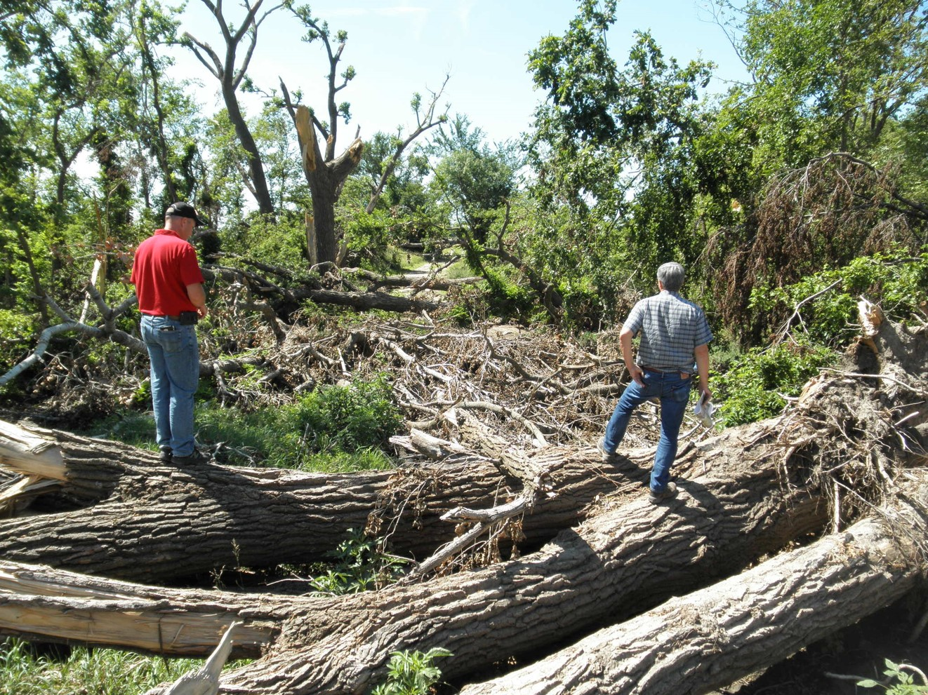
EWP Working for Communities
Dickinson County
Tornado debris removal.
This is 1 of 9 sites under construction.
Funded for $1.1 M
When tornado debris threatens streams and watersheds
Notes:
The is a photo of debris removal in Dickinson County.
Now the next slide.

Slide 17
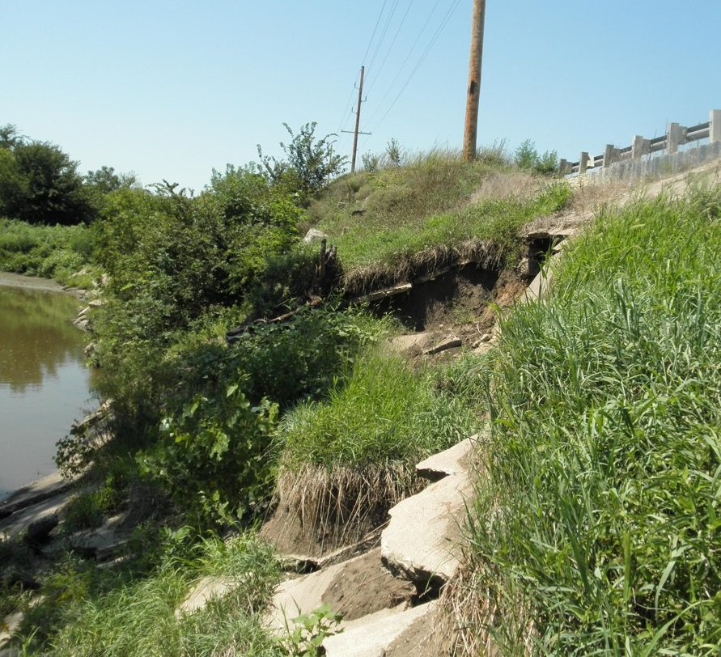
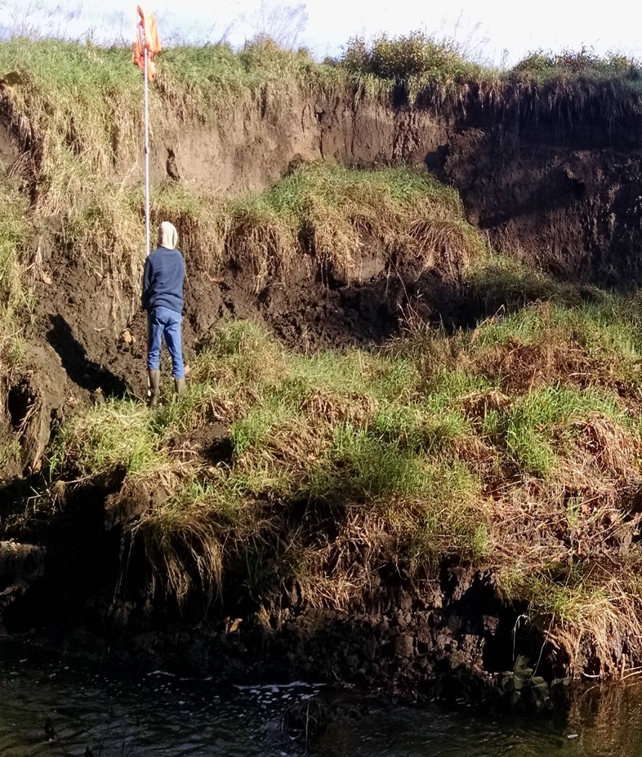
EWP Working for Communities
Marion County
Brown County
Non-exigency damage, out for bid
$554,000
Exigency damage, comp. Feb. 2017
$245,270
When flooding cause streambank erosion
Notes:
On the right, this shows the streambank damage in Brown County. This exigency project was completed in February.
On the left, Marion County project’s design is completed and is out to bid.
Next slide. This wraps up my presentation.
Are there any questions?
Thank you!

Slide 18
Thank You !
Notes:
Be glad to take questions

Slide 19
USDA Nondiscrimination Statement
Non-Discrimination Policy
In accordance with Federal civil rights law and U.S. Department of Agriculture (USDA) civil rights regulations and policies, the USDA, its Agencies, offices, and employees, and institutions participating in or administering USDA programs are prohibited from discriminating based on race, color, national origin, religion, sex, gender identity (including gender expression), sexual orientation, disability, age, marital status, family/parental status, income derived from a public assistance program, political beliefs, or reprisal or retaliation for prior civil rights activity, in any program or activity conducted or funded by USDA (not all bases apply to all programs). Remedies and complaint filing deadlines vary by program or incident.
Persons with Disabilities
Persons with disabilities who require alternative means of communication for program information (e.g., Braille, large print, audiotape, American Sign Language, etc.) should contact the responsible Agency or USDA’s TARGET Center at (202) 720-2600 (voice and TTY) or contact USDA through the Federal Relay Service at (800) 877-8339. Additionally, program information may be made available in languages other than English.
To File a Program Discrimination Complaint
To file a program discrimination complaint, complete the USDA Program Discrimination Complaint Form, AD-3027, found online at How to File a Program Discrimination Complaint and at any USDA office or write a letter addressed to USDA and provide in the letter all of the information requested in the form. To request a copy of the complaint form, call (866) 632-9992. Submit your completed form or letter to USDA by:
(1) mail: U.S. Department of Agriculture
Office of the Assistant Secretary for Civil Rights
1400 Independence Avenue, SW
Washington, D.C. 20250-9410;
(2) fax: (202) 690-7442; or
(3) email: program.intake@usda.gov.
USDA is an equal opportunity provider, employer, and lender.

