Slide 1
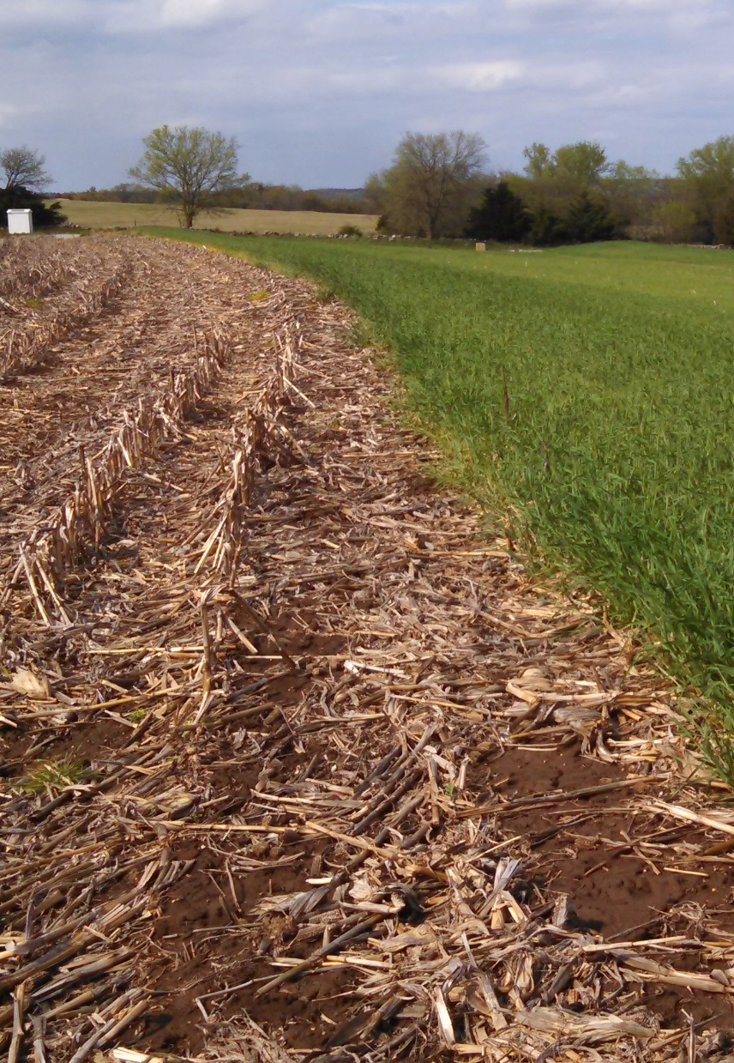
Cover Crops for Soil and Nutrient Conservation
Nathan Nelson
Co-PIs: Kraig Roozeboom, Gerard Kluitenberg, Peter Tomlinson, and Jeff Williams
Graduate Students: David Abel and Elliott Carver

Slide 2
Cover Crop Craze
Notes:
Cover crops are cited for providing many benefits to soils: soil health, nutrient scavenging, N fixation, reduced erosion, improved water quality, etc. Some of these have been studied intensively, while others have not. Soil erosion and P loss impacts have been primarily studied in conventional till systems, very little or no data in no-till systems.

Slide 3
Fertilizer management
Notes:
Pros:
Faster than sub-surface placement
Easier to contract out
Large application window
Less expensive
Cons:
May increase P loss in surface runoff and decrease water quality

Slide 4
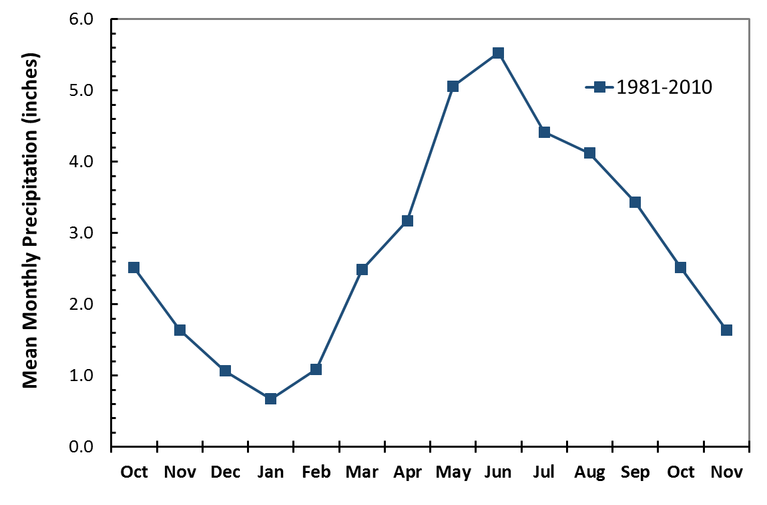
Apply fertilizer when the crop needs it
Split applications (for N)
Apply close to planting (for P?)
Apply when there is less chance for loss

Slide 5
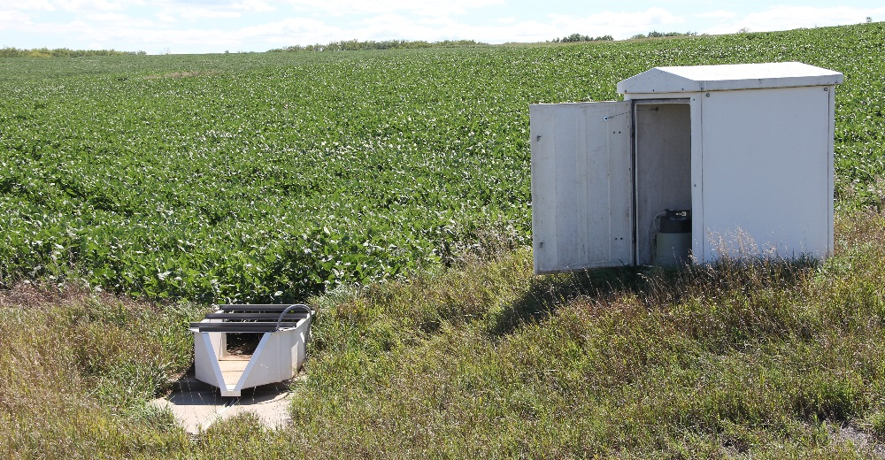
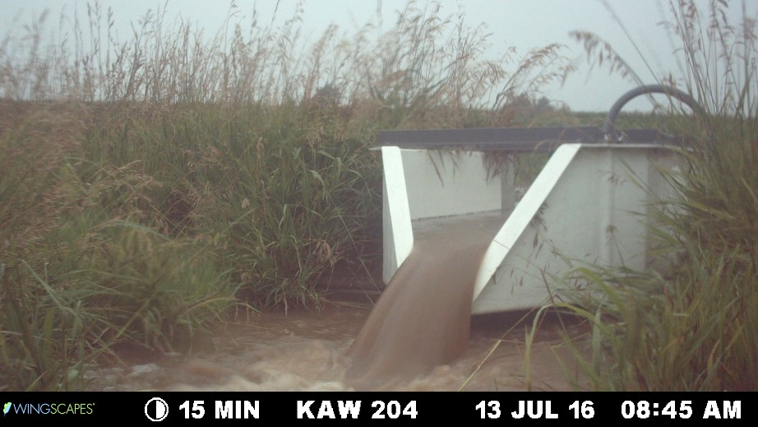
How will cover crops affect sediment and P loss?
Will cover crops reduce sediment loss in no-till?
Will cover crops reduce P loss?...
…with surface broadcast fertilizer?

Slide 13
Event-based flow-weighted composite samples
Runoff
Sediment
Total P
Dissolved P

Slide 14
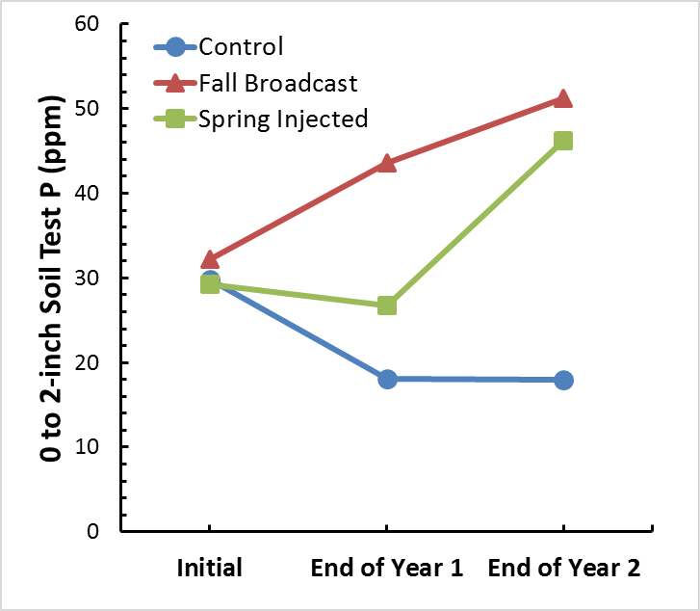
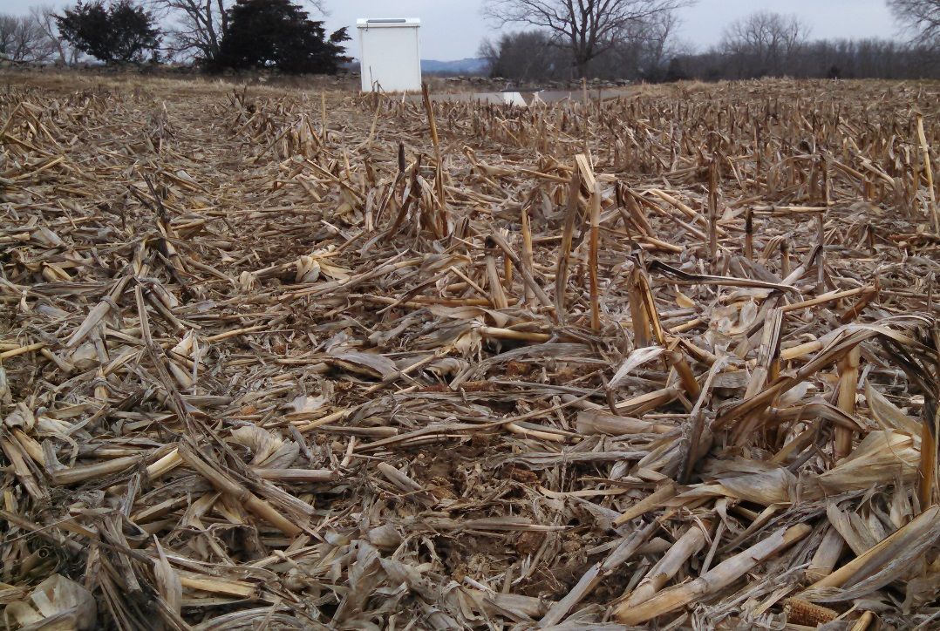
Agricultural systems require time to fully respond to treatments
Completed 2 years of a 5-year study

Slide 15
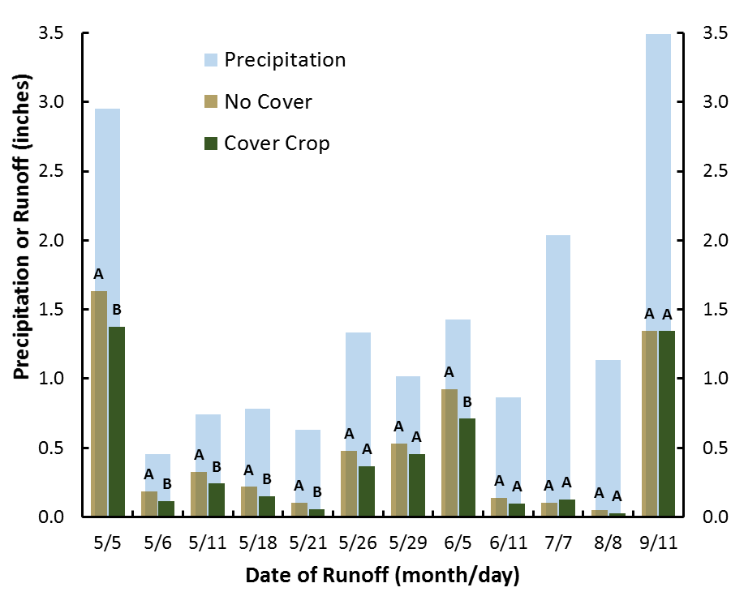
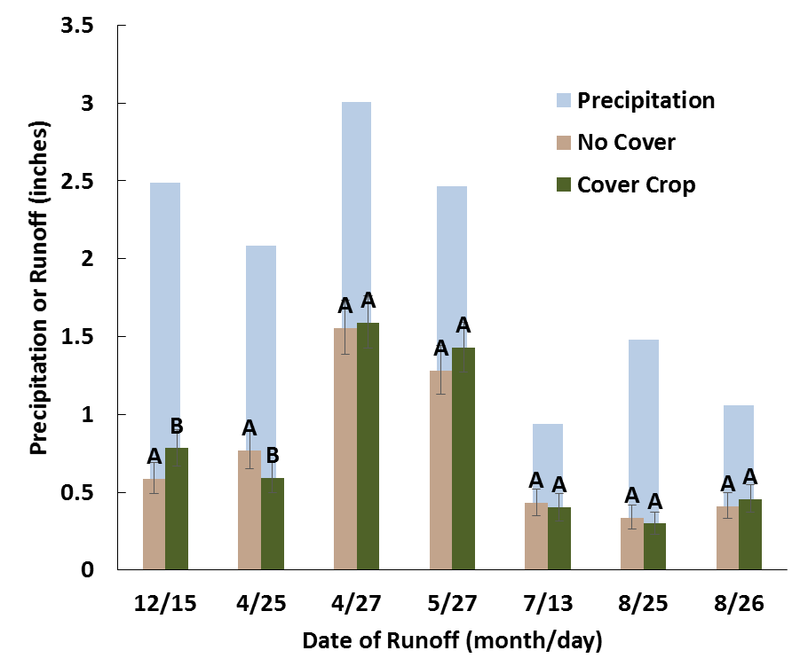
Cover crop impacts on runoff
2015
2016
17% reduction in runoff
little difference in runoff

Slide 16
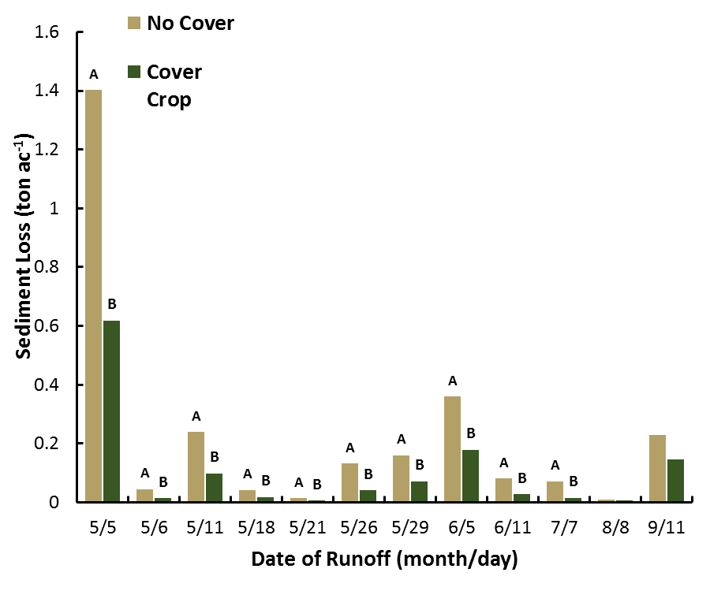
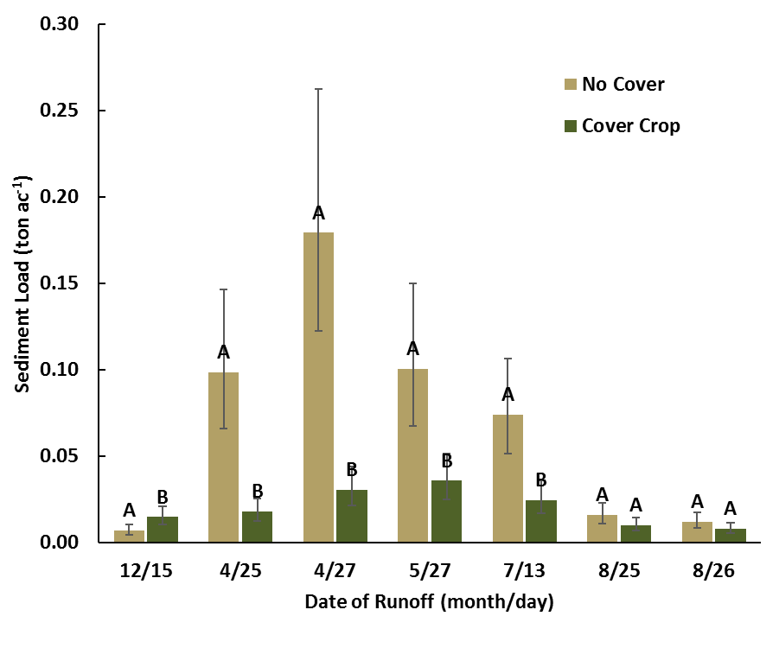
Cover crop effects on sediment loss
2015
2016

Slide 17
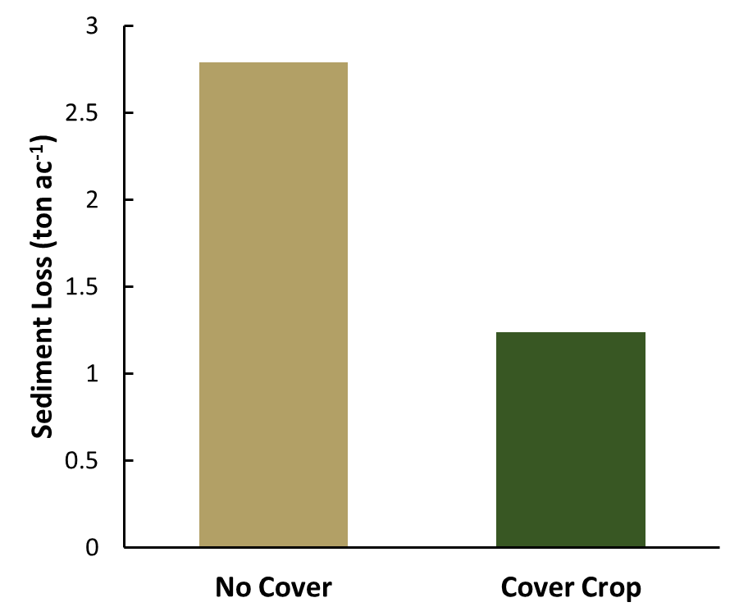
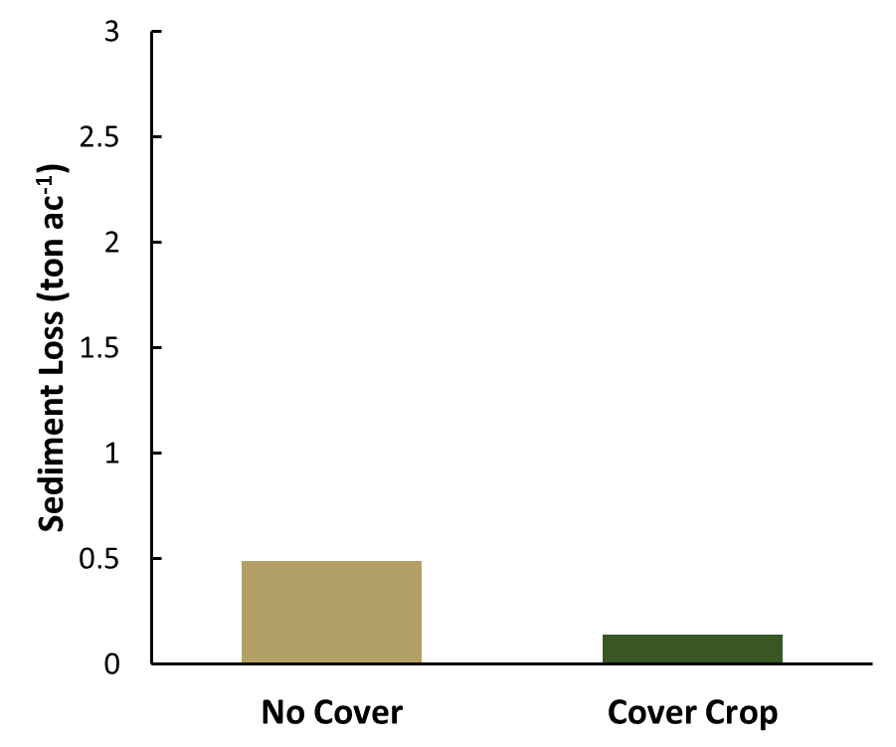
Cover crop effects on sediment loss
2015
2016
p<0.001
p=0.002
50% reduction
70% reduction

Slide 18
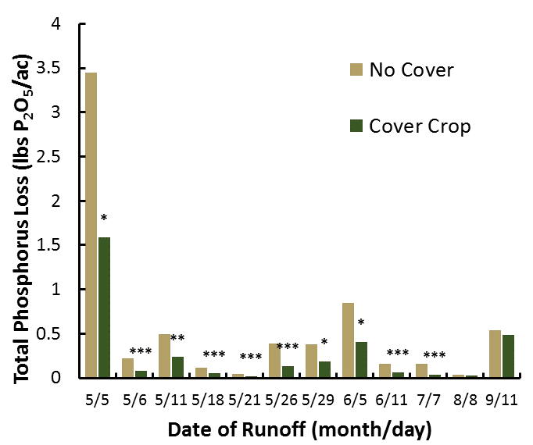
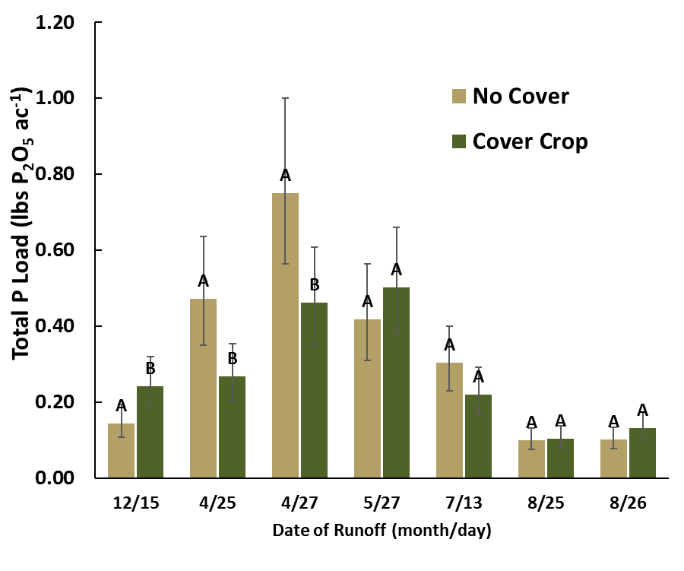
Cover crop effects on total P loss
2015
2016

Slide 19
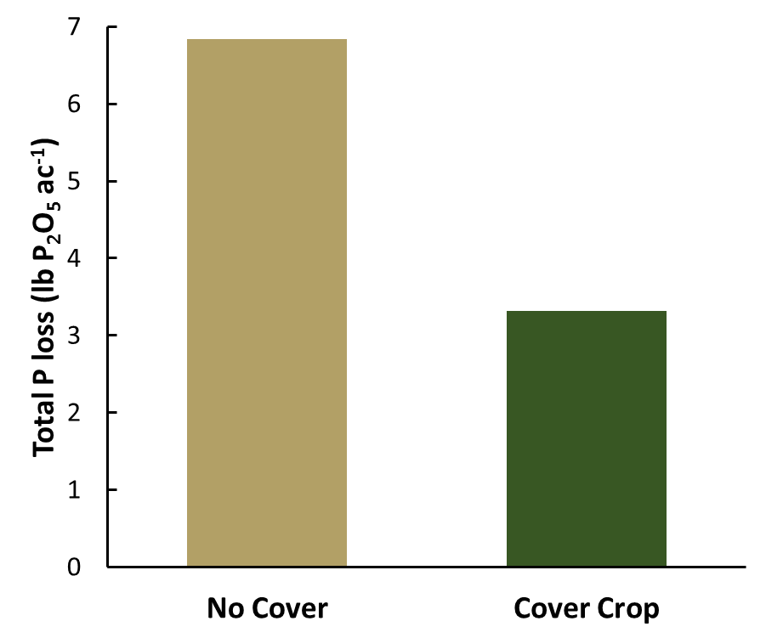
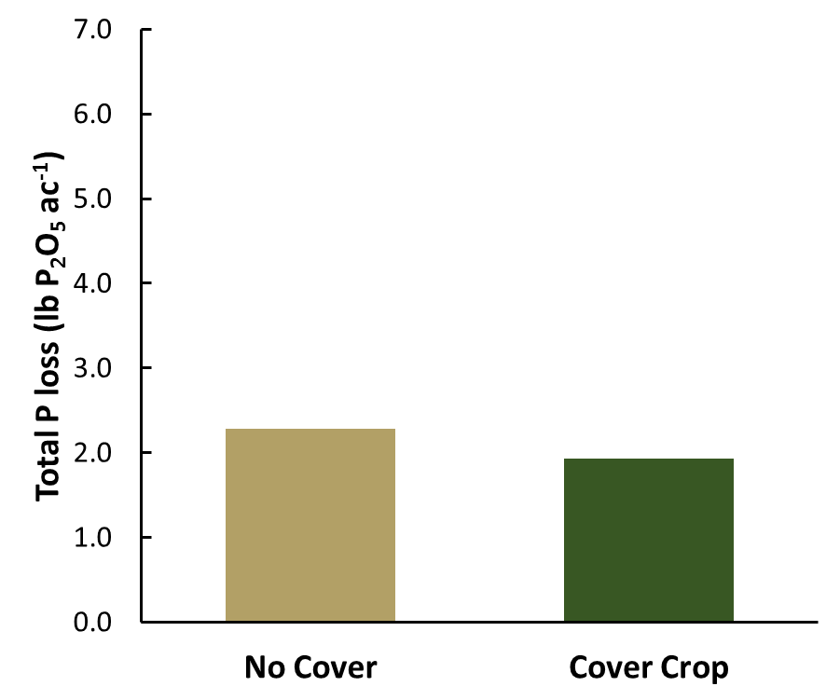
Cover crop effects on total P loss
2015
2016
p<0.001
p=0.49
50% reduction

Slide 20
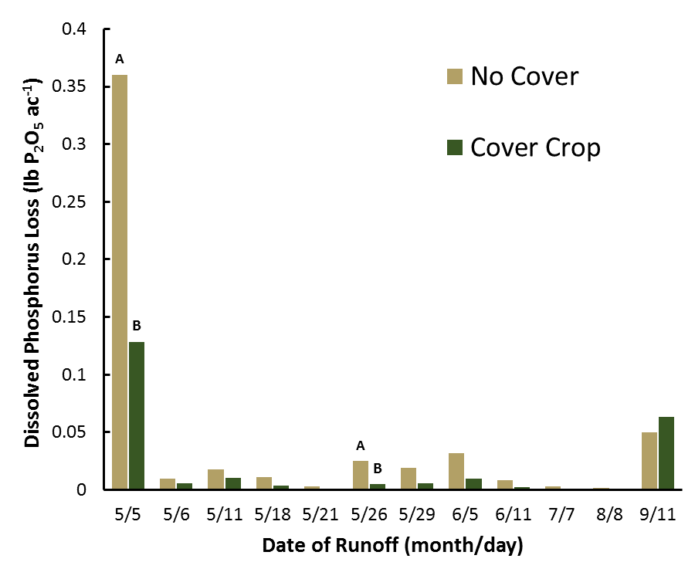
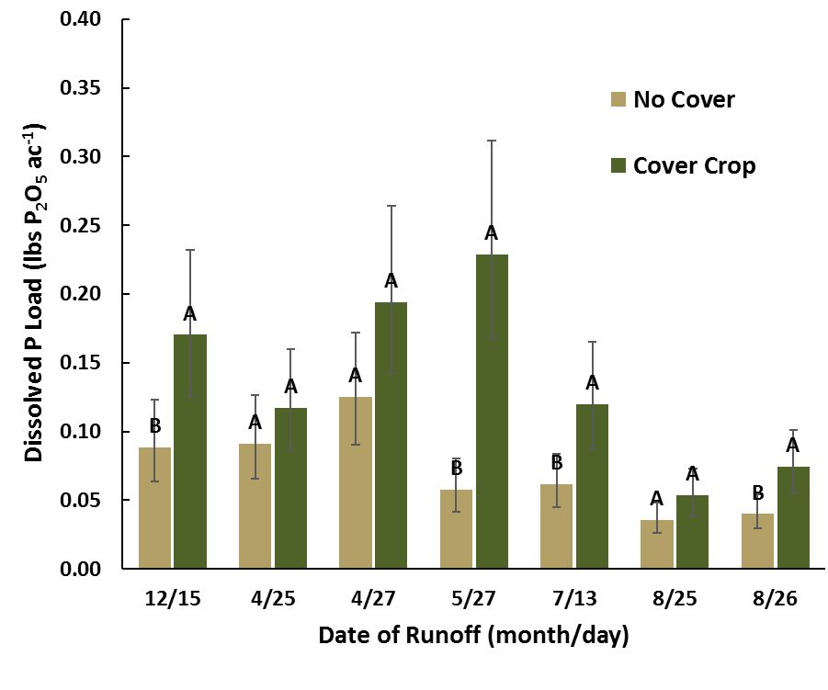
Cover crop effects on dissolved P loss
2015
2016

Slide 21
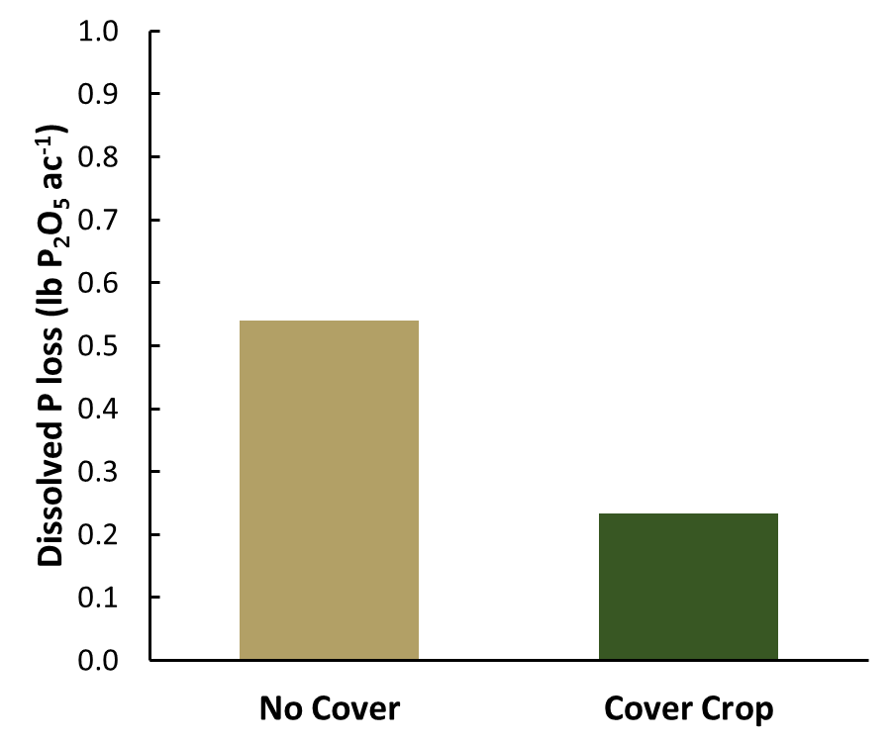
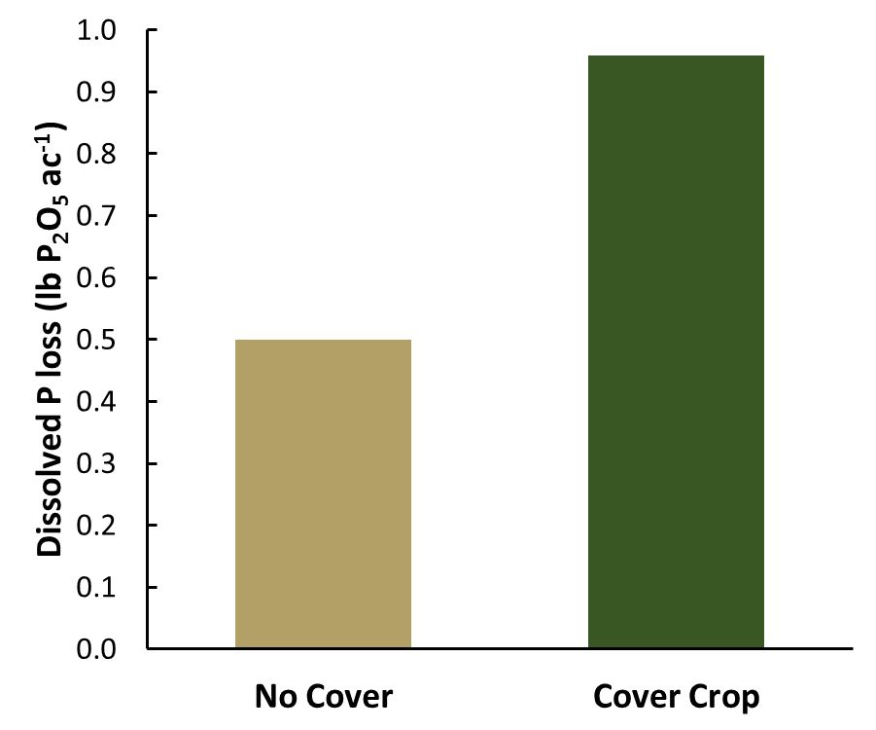
Cover crop effects on dissolved P loss
2015
2016
p=0.053
p=0.003

Slide 22
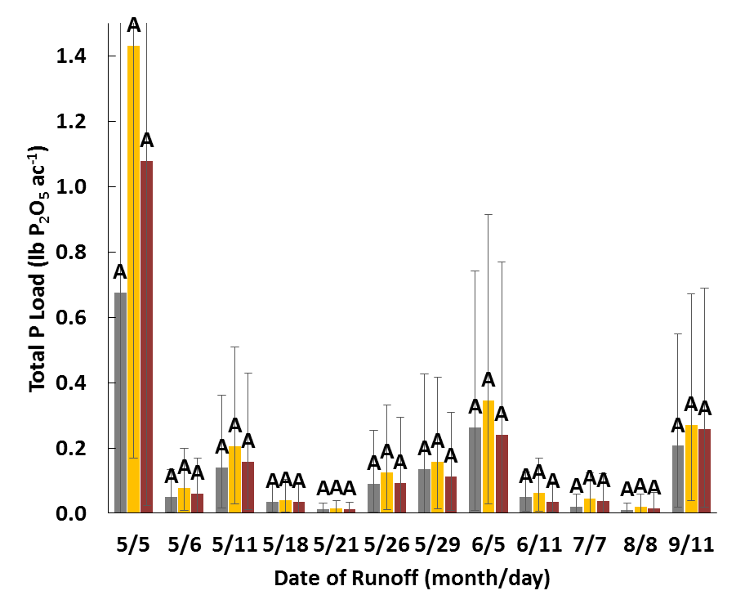
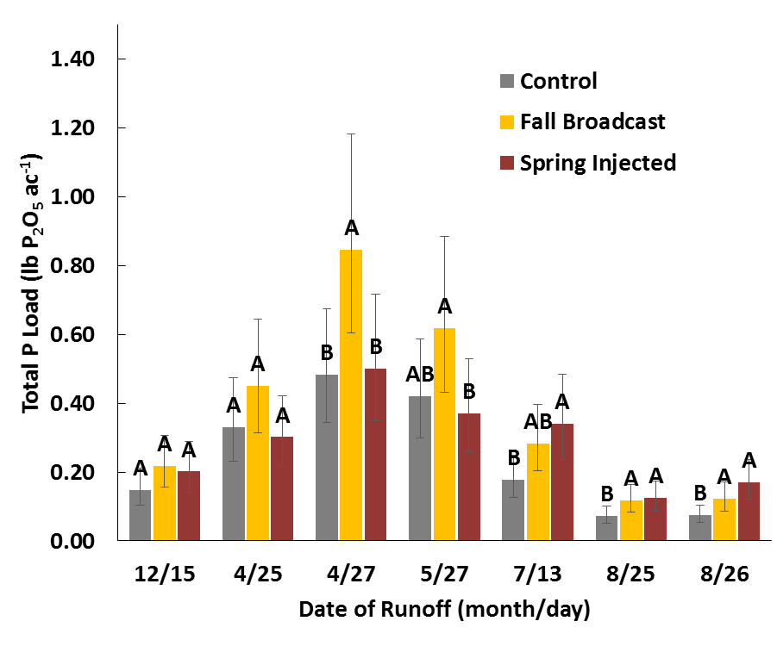
Fertilizer placement effects on total P loss in runoff water
2015
2016
p=0.98
p=0.002

Slide 23
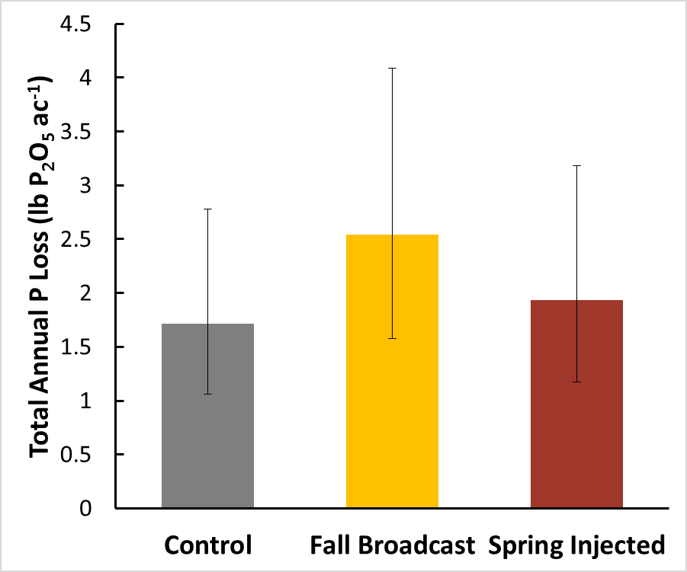
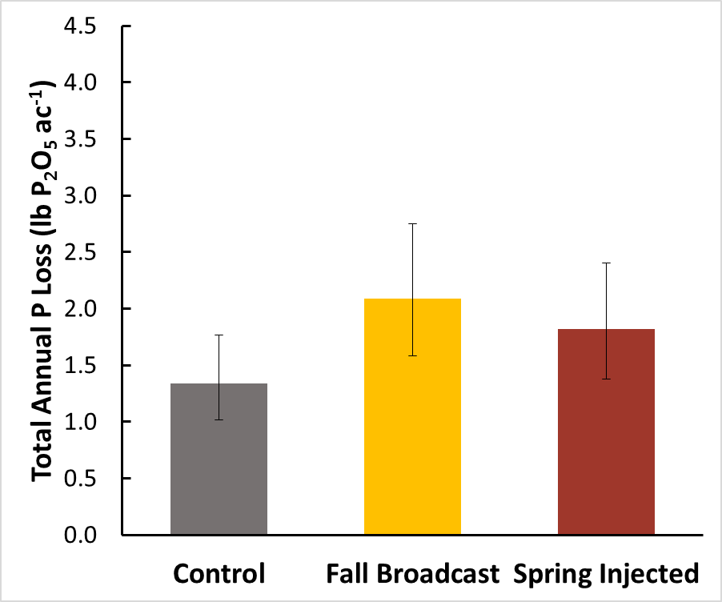
Fertilizer placement effects on total P loss in runoff water
2015
2016
p=0.46
p=0.075

Slide 24
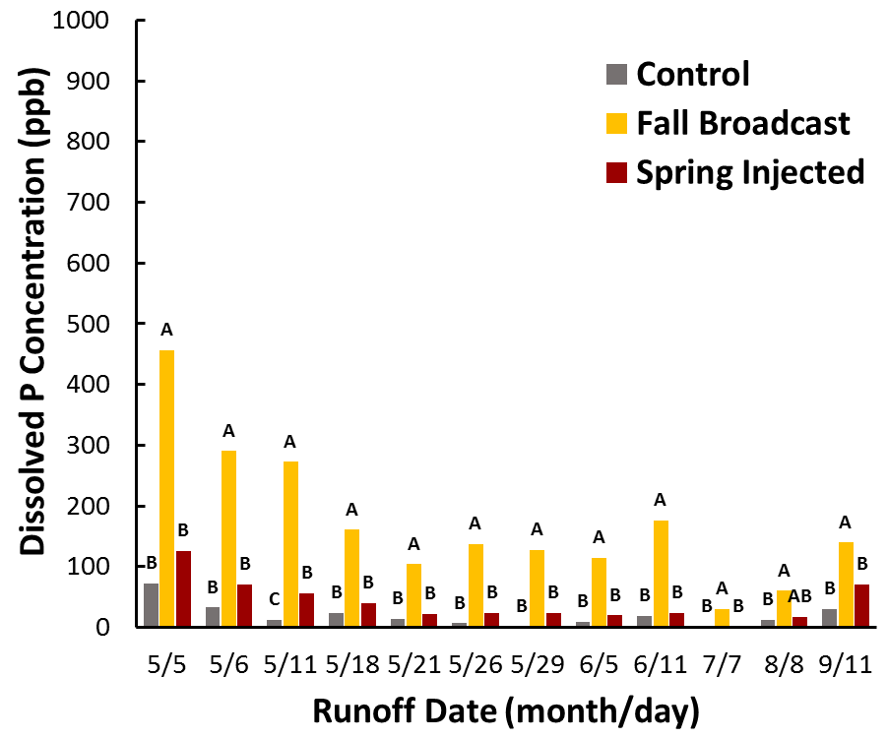
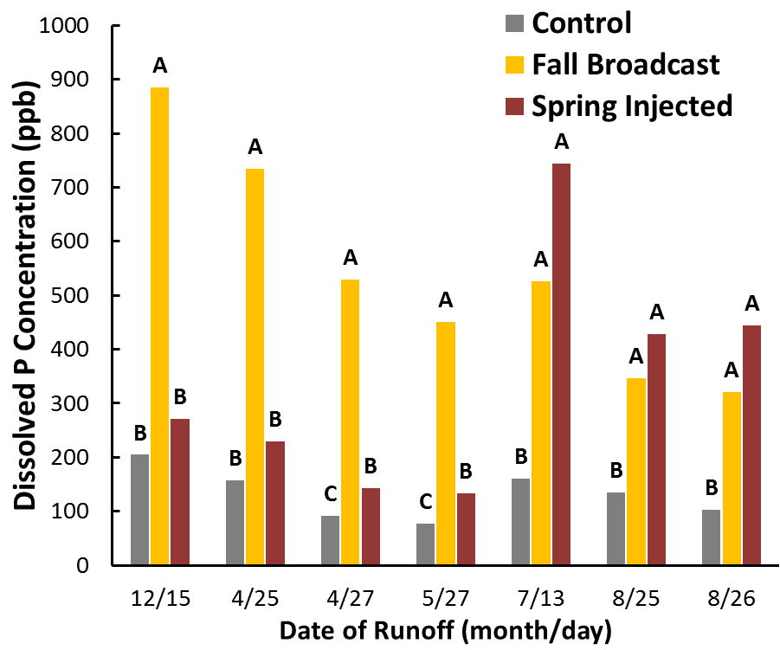
Fertilizer placement effects on dissolved P concentration in runoff water
2015
2016

Slide 25
Summary of Preliminary Data
Cover crops reduce sediment loss
Cover crops will influence runoff (some decrease, some increase)
Cover crops influence total P and dissolved P loss (some decrease, some increase)
Placement had little effect on total P loss **if at the right time**
surface broadcast had higher surface soil test P and higher dissolved P loss.

Slide 26
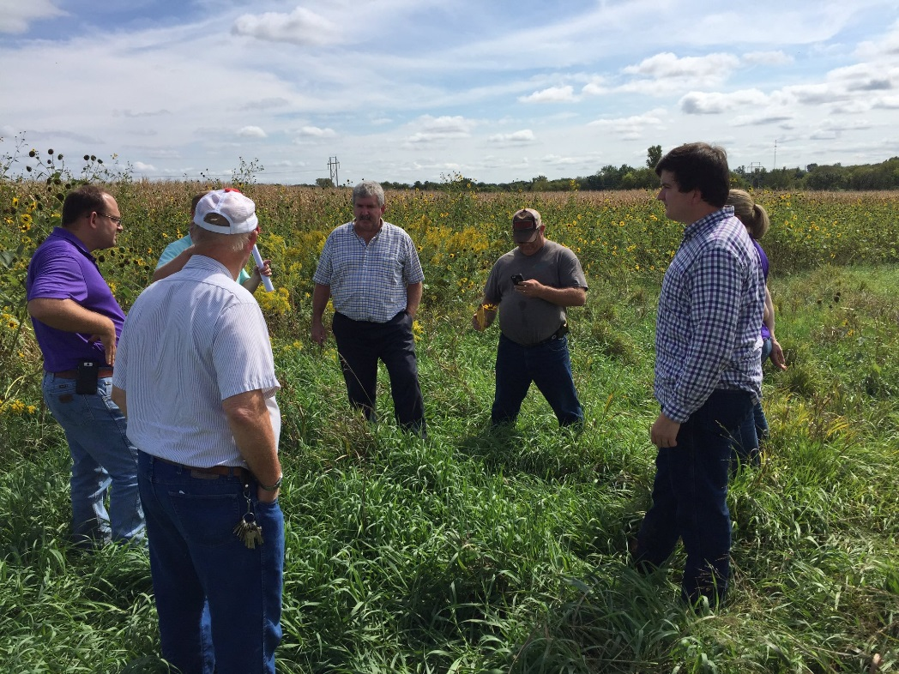
Collaborative efforts: On-Farm Research

Slide 27
Thank you to our funding sources

Slide 28
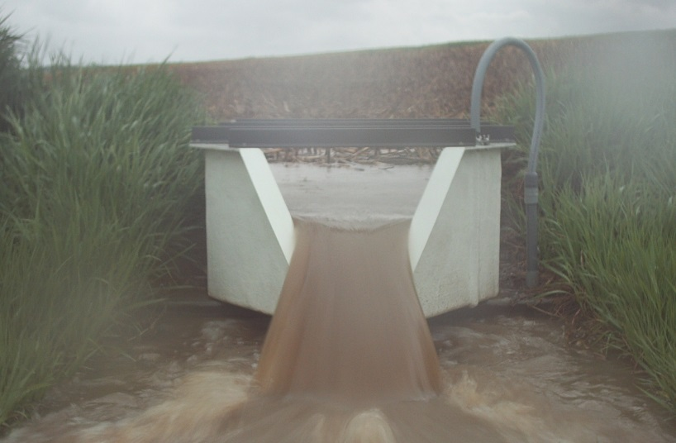
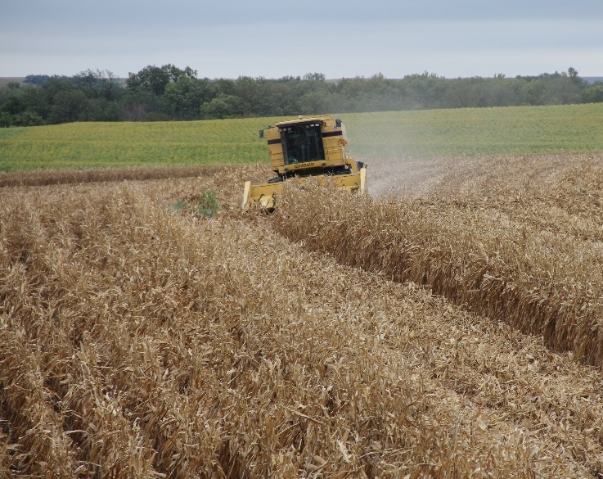
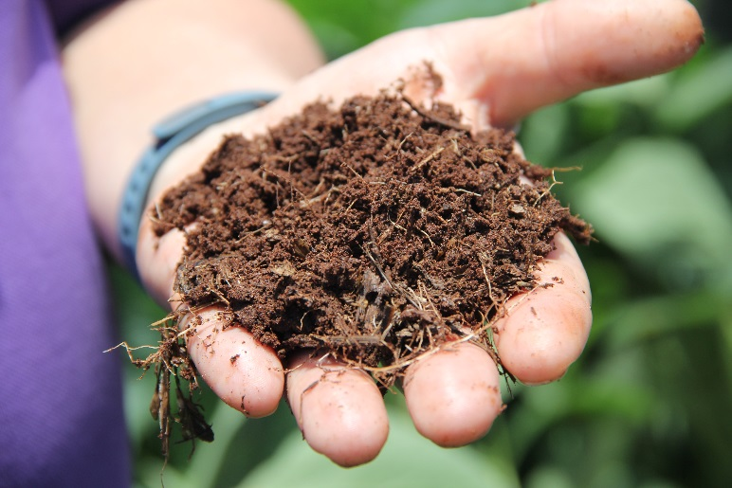
Questions?

