Slide 1
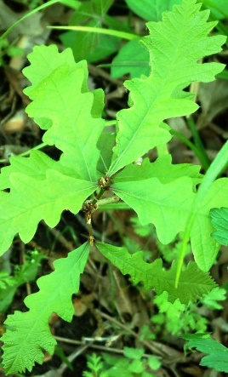
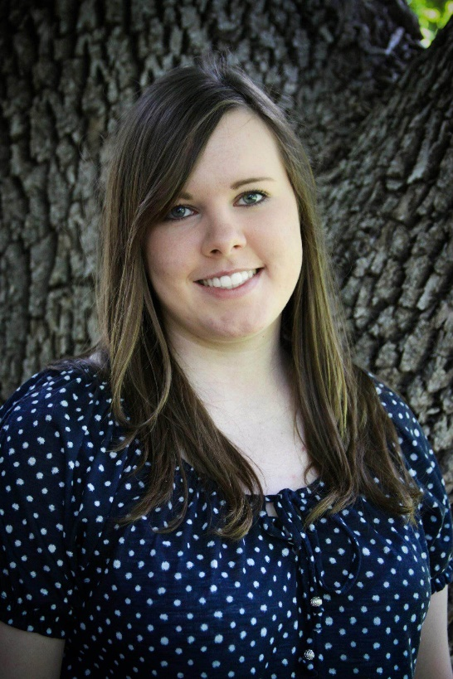
Kansas Forest Service 2017 Report SCC Spring Workshops
Jami Seirer new District 7 forester (Sept 2016)
NRCS Area 1 Office, Hays (jseirer@ksu.edu; 785-410-2956)
A western Kansas native from Garden City area
Father was wildlife biologist with KDWPT
Graduate of Fort Hays State University 2012 (computer science)
MS in Forestry, University of Montana in Missoula,
Emphasis in GIS and remote sensing

Slide 2
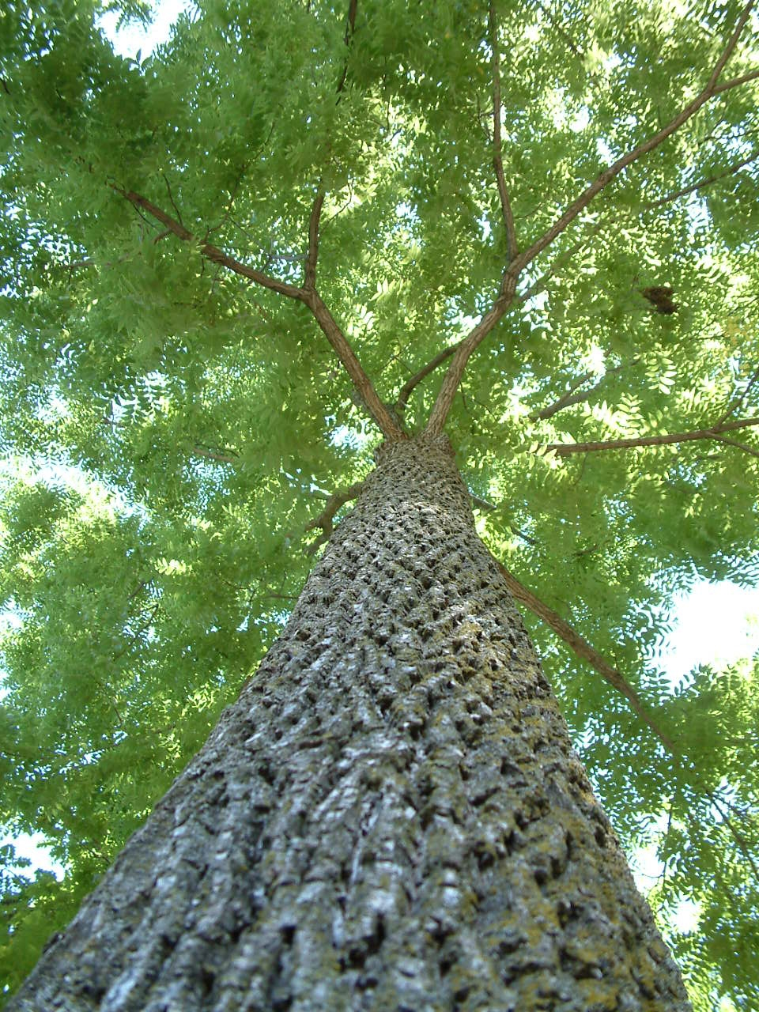

Slide 3
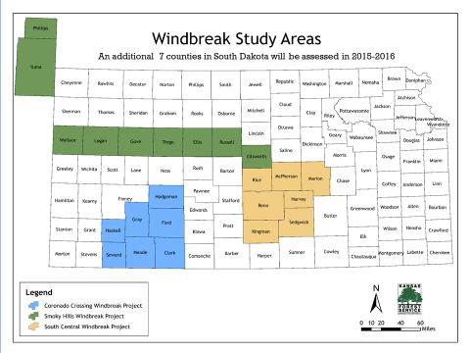
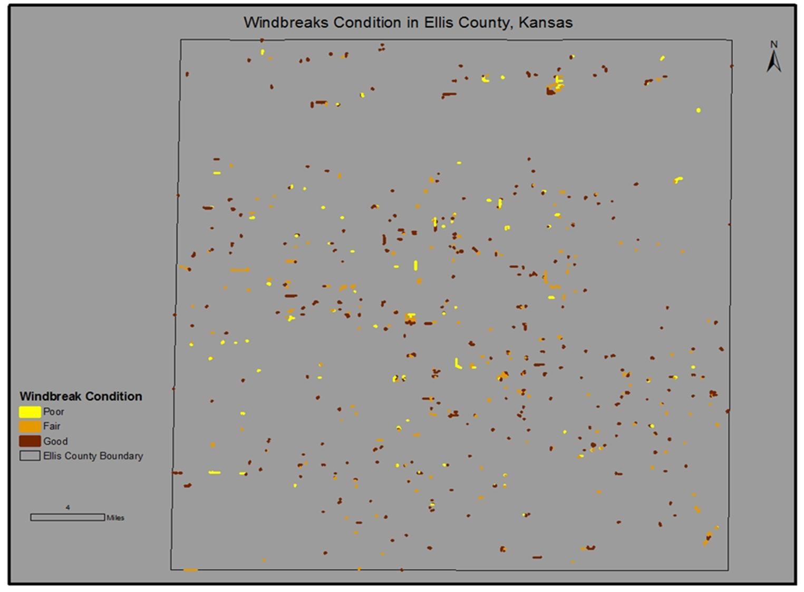
County Conservation District Outreach 2018??
Thanks to Tanya Allemang, Dana Charles, Bev Elder & others…

Slide 4
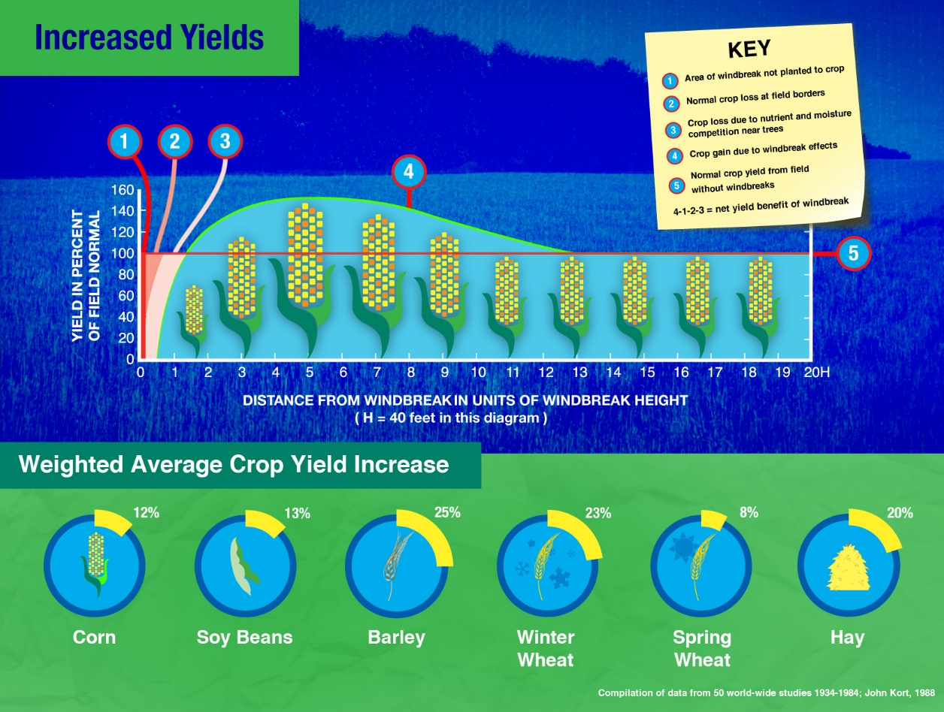
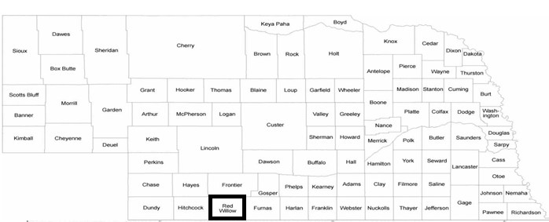
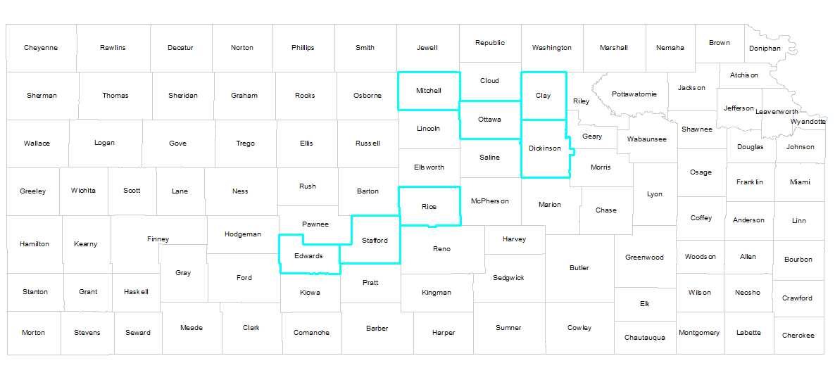

Slide 5
Kansas/Nebraska Data Collected
410 crop/years
Kansas
Mitchell: 16 crop/years
Stafford: 2 crop/years
Edwards: 32 crop/years
Ottawa: 26 crop/years
Rice: 38 crop/years
Dickinson: 111 crop/years
Clay: 152 crop/ years
Nebraska
Red Willow : 33 crop/years
8 Counties
8 farmers
5 crops:
Wheat
Milo
Soybeans
Corn
Sunflowers

Slide 6
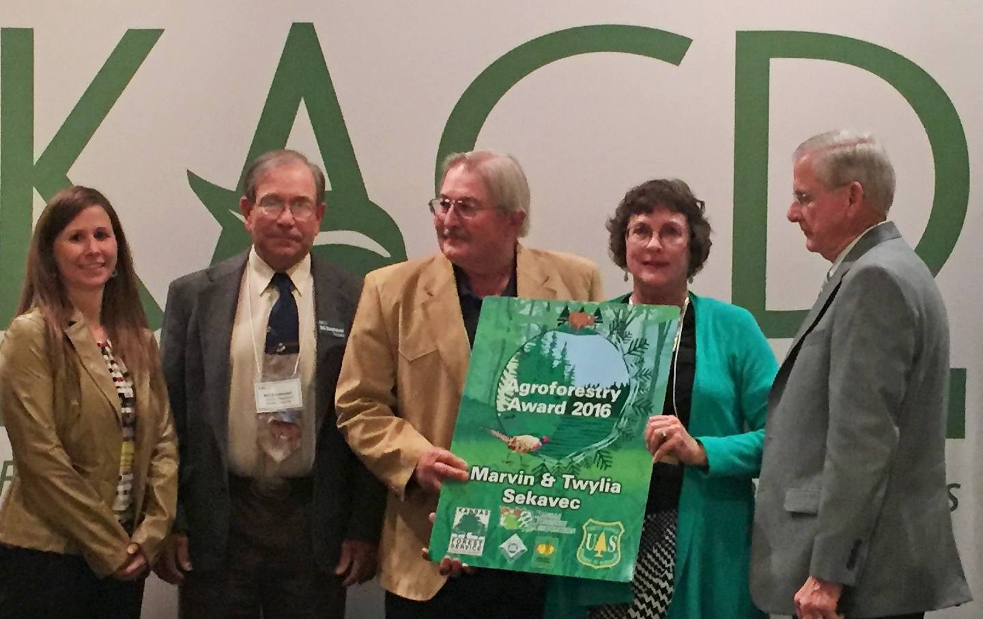
Intentional Partnership Agroforestry Field Day?
Incorporating trees and shrubs into contemporary agricultural systems
Partnership Ideas
Focus KACD Areas 1, 2, & 3
Bill Simhausser, Jerry Claussen & Allen Roth Assisting
Rotate field day to different areas each year
Try to recognize and award winner annually
KFS & KACD create agreement of respective roles
Local conservation districts have freedom in event organization
Work with Wildlife, Forestry & Recreation Committee
Nominated for 2015 KS Agroforestry Award KS Forestry Association

Slide 7
Environmental Quality Incentives Program for Forestland Health
$198,640 FFY 2017 for Windbreak Renovation and other practices
Some Eligible Practices and Rates
Mechanical Mowing $9.20/AC
Herbicides (banding) $25.75/AC
Weed Barrier Fabric (squares) $1.87/EA
Weed Barrier Fabric (rolls) $0.47/FT
Tree/Shrub Site Prep (chemical) $119.78/AC
Tree/Shrub Site Prep (light) $44.18/AC
Tree/Shrub Site Prep (medium) $169.55/AC
Tree/Shrub Site Prep (heavy) $191.06/AC
Direct Seeding (Riparian Buffer) $632.64/AC
Tree Planting (Machine & Tubes) $5.73/EA
Tree Planting (Hand/Browse Protection) $4.04/EA
Tree Planting (Machine) $1.68/EA
Riparian Forest Buffer Tree
Planting, Container & Machine $1,475.94/AC
Riparian Forest Buffer Tree
Planting, Bare Root & Machine $937.40/AC
Barbed Wire Fence (multi strand ) $1.04/FT
Forest Stand Improvement (single stem treatment) $208.41/AC
Windbreak Renovation
Supplemental Planting BR $0.15/FT
Windbreak Renovation
Row Removal—Dozer $1.66/FT

Slide 10
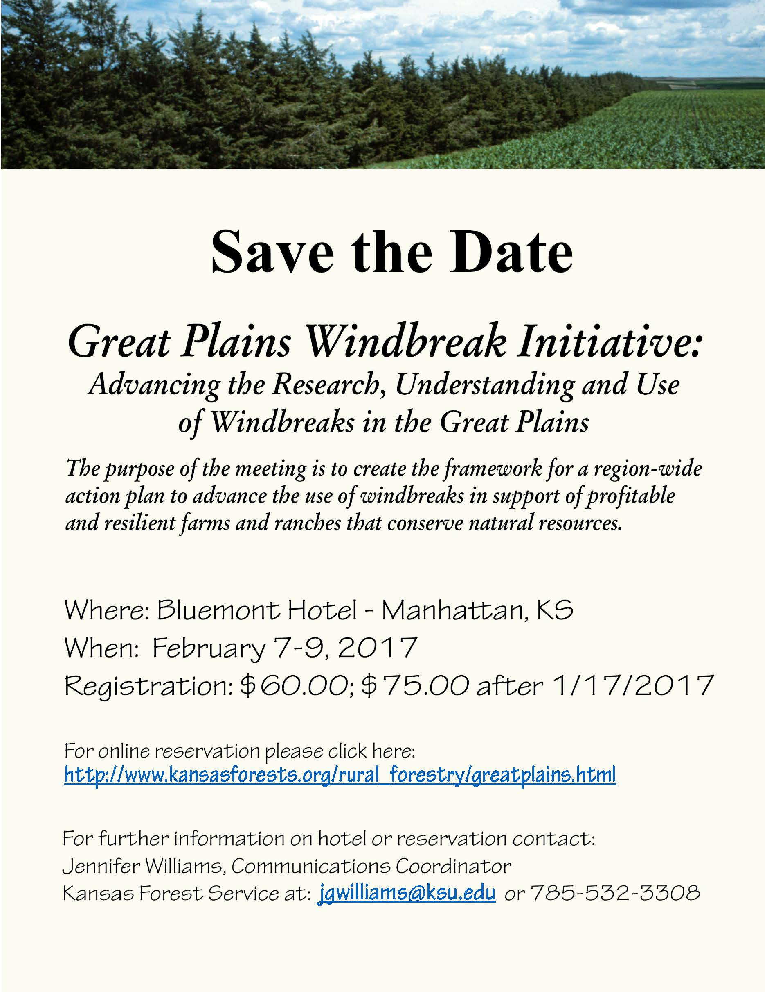

Slide 11
Creating a State-wide Tree Canopy Layer for Kansas Using NAIP 2015 Imagery

Slide 12
Final Product
75 out of 105 counties are complete/Begin on 2010 Imagery

Slide 13
Documenting Extent & Location of All Kansas Windbreaks

