Slide 1





2017 Spring Workshops
Welcome!!

Slide 2
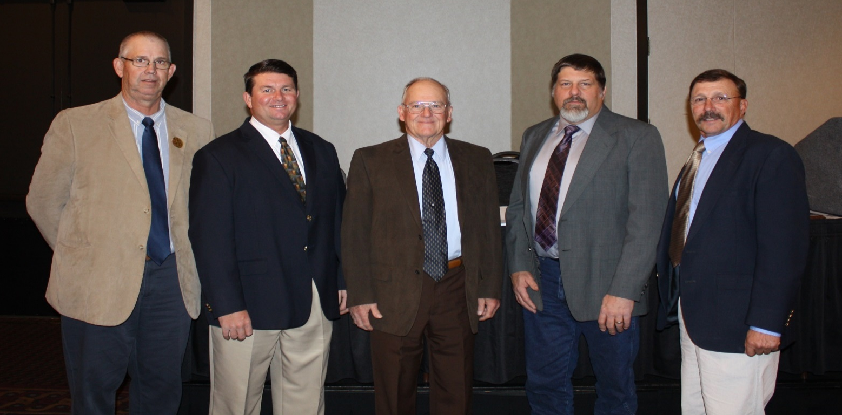

Welcome & Introductions
Elected Commissioners
Area I – Ted Nighswonger
Area II – Andy Larson
Area III – Brad Shogren
Area IV – John Wunder, Vice-Chair
Area V – Rod Vorhees, Chair

Slide 3
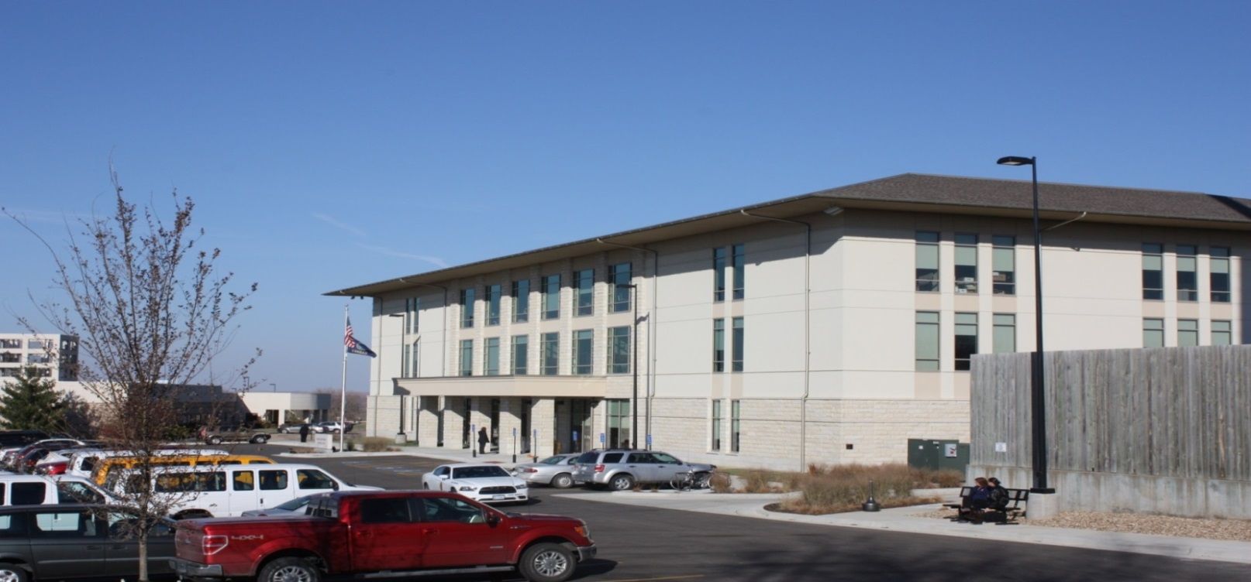

Division of Conservation (DOC) Report / Updates

Slide 4
Legislative Update
Substitute for HB 2272 – Establish the Kansas Water Authority Science & Research Subcommittee
Subcommittee would carry out the following duties:
  Recommend research priorities and necessary funding levels for research that will better determine the causes of ground water and surface water sustainability and water quality problems and alternative water sources;
  Scientifically evaluate the effectiveness and cost effectiveness of State Water Plan funded projects and programs; and
  Recommend re-prioritization of State Water Plan funded projects and programs, if necessary, and recommend funding levels necessary to carry out the project and programs

Slide 5
Legislative Update (cont)
HB 2032 – Increasing fees credited to the state water plan fund.
HB 2311 – Maintenance requirements for streambank stabilization and water quality protection projects.
SB 48 – Remedies for the impairment of a valid water right or permit to divert and use water.
KDA has coordinated with KLA, KFB, the GMDs, KWA and other stakeholders to develop an alternate proposal to modify the water right impairment process and streamline the paths senior water right holders could pursue when they believe themselves impaired.

Slide 6
Legislative Update (cont)
SB 27 – Appropriation revisions for FY 2017, 2018 & 2019 for various state agencies
  Proposed to delete $189,972, all from the State General Fund, to reduce the agency’s budget by
  2% in FY 2017

Slide 7
Legislative Update (cont)
HCR 5008 - Proposition to amend article 11 of the constitution of the state of Kansas concerning the state water plan fund
SGF/EDIF Request – House Water & Environment Committee, Chaired by Rep. Tom Sloan, considered many different SWPF fee and revenue bills this session.
  Chairman Sloan asked KWO and stakeholders to produce a more detailed priority project list for potential SGF/EDIF funding.
  Recommendation was submitted to Chairman Sloan on February 27th.

Slide 8
Blue Ribbon Task Force
Funding to the Long-Term Vision for the Future of Water Supply in Kansas (The Vision)
  Potential additional source of funding
  Charged with developing a method to provide financing for water resource management and protection
  Final report submitted to Governor Sam Brownback dated January 11, 2017
  $55 million to address water quantity and quality concerns
  Transfer of $6 million general fund; $2 EDIF to the SWPF

Slide 9
State Water Plan Fund
$13,919,461 - $21,919,461

Slide 10
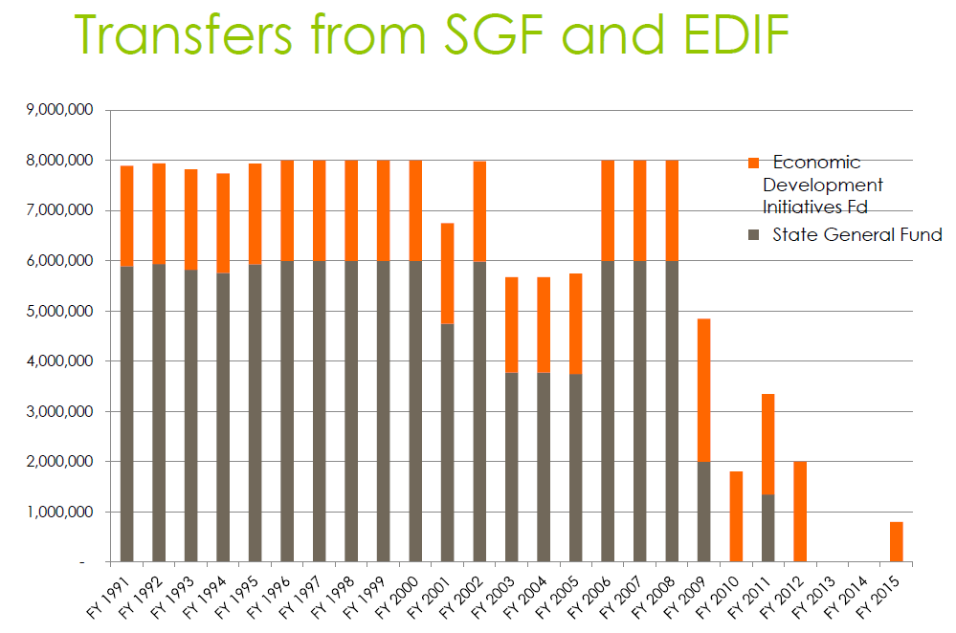

Slide 11
State Water Plan Budget
 | DOC Programs | FY 2017 | FY 2018 | HIGHEST
 | Conservation District Aid | $2,092,637 | $2,000,000 | $2,325,000
 | Water Resources Cost-Share | $1,948,289 | $1,727,387 | $5,736,772
 | Non-Point Pollution Cost-Share | $1,858,350 | $1,503,015 | $3,623,854
 | Watershed Dam Construction | $576,434 | $511,076 | $1,577,248
 | Water Supply Restoration / MSL | $281,312 | $0
 | CREP / WTAP | $449,578 | $177,324 | 1.4 Mil/700K
 | Water Quality Buffer Initiative | $249,792 | $88,662 | $350,000
 | Riparian & Wetland | $152,651 | $135,343 | $300,000
 | TOTAL | $7,605,505 | $6,142,807

Slide 12
SCC Prioritization of SWP Funds
Prioritizing DOC budget
  1) Aid to Conservation Districts
  2) Water Resources Cost-Share Program
  3) Non-Point Source Pollution Control Cost-Share Program
  4) Water Conservation Programs (WTAP & CREP)
  5) Watershed Dam Construction Program
  6) Riparian & Wetland Protection Program
  7) Kansas Water Quality Buffer Initiative Program
  8) Water Supply Restoration Program
  9) Multipurpose Small Lakes Program

Slide 13
Regional Conservation Partnership Program
Kansas Projects with DOC as a Partner
  Improving Water Quality through implementation of forestry practices and the assessment of riparian systems in Kansas priority watersheds (KSU-Kansas Forest Service)
  Middle & Lower Neosho River Water Quality Project (OK / KS)
  Milford Lake Harmful Blue-Green Algal Blooms
    Being developed (lead partner KWO)

Slide 14
Regional Conservation Partnership Program (cont)
Other Kansas Projects
  Advanced Irrigation Water Management on the High Plains Aquifer in Kansas (SW Groundwater Mgmt District #3)
  Pheasant Initiative (KDWPT)
  Grassland Birds and Grazing Land Enhancement Initiative (KDWPT)
  Native Grazing Lands Protection in the Plains (The Nature Conservancy)

Slide 15
Watershed District
Cost-Share Program
Watershed District must have updated General Plan to include cost-share Best Management Practices (BMP’s).
Watershed District decides which BMP’s to cost-share on while also deciding cost-share rates, avg. costs and landowner limits.
Watershed District enters into a Memorandum of Agreement with the DOC to administer funds through CSIMS.
Currently 2 WD’s participating (Cedar Creek WJD #97 and Cherry Plum WJD #17).

Slide 16
Soil Health Education Funds
Funds will be available again in FY 2018
  Workshops, Field Days
  Educational materials, cover crop seed etc.
  Cover Crop and Grazing Management
  $2,500 limit per application for workshop
  No-till on the Plains Winter Conference registration fees (Under Review)
    CD Supervisors
    Landowner, operator first time attendees

Slide 17
Sediment and Nutrient Reduction Initiative
Proposal to enroll up to 10,000 acres
One time incentive payment ($225 per acre in Tier 1; $162.50 per acre in Tier 2)
Potential practices could include (CP8-grassed waterways, CP21-filter strips, CP22-riparian buffer, etc.)

Slide 18
Sediment and Nutrient Reduction Initiative (cont)
Will replace the current Water Quality Buffer Initiative Program
Partnership between landowners and local, state, federal and private non-profit agencies / entities.

Slide 19
Supplemental Allocation of Cost-Share Funds
FY 2017 Cancellation of Uncommitted Funds
  March 2nd
FY 2017 Reallocation of Funds
  As soon as possible after March 6th

Slide 20
FY 2018 State Cost-Share
Program Revisions
Add forage balance estimate worksheet/ grazing management plan language as policy to practice code 512 (Forage and Biomass Planting), if practice will be grazed. (WR & NPS)
Add lagoon to practice code 110A (Elimination of Abandoned On-Site Wastewater System) per KACD resolution passage. (NPS only)

Slide 21
Cost Share Reminders
FY 2015 WR & NPS contracts expire June 1, 2017.
FY 2016 WR & NPS contracts expire June 1, 2017, except LWM & RW contracts will expire on June 1, 2018.
FY 2017 OSW and AWP contracts expire June 1, 2017.
CSIMS will close on or around June 16, 2017 for all FY contract activity.

Slide 22
CSIMS 2.0 Upgrade
Conversion of Oracle to SQL Server Database
October 31st all coding and functionalities completed
Early November – rollover for full version production
New Features to Home Page
Calendar for Important Dates
Message Board
    CS-1 District Allocation posted in CSIMS
    Worklist
      CS-3 Contract for Financial Assistance Rejected

Slide 23
CSIMS 2.0 Upgrade (cont.)
    Email Notifications
    CS-2 District Program & Ranking Worksheet Approved
Training Opportunities
KACD-EO Statewide Meeting May 2-3, 2017 Salina
KACD Annual Convention November, 2017 Wichita

Slide 24
Program Performance
Critical to document State Water Plan Fund investments in programs
Ranking Worksheet – Expectations
  To capture unmet needs in priority targeted areas for future / additional funding
Emphasis on Program Development
Load Reduction Calculation
  Mapping

Slide 25

Open Discussion

