Slide 1
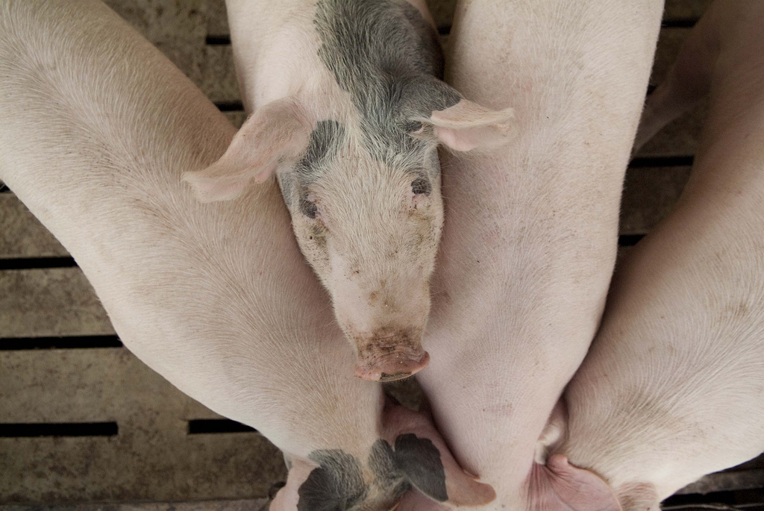
Drug Residue Avoidance in Swine

Slide 2
Swine Industry
The swine industry is a vertically integrated industry which encompasses both live swine and the production of pork. The demand for pork products has inclined in recent years, because of this the industry has met the need by becoming more efficient.
Antibiotics are used to both to treat disease and increase efficiency of the pigs.
Notes:
Pull general stats

Slide 3
Drug Residue vs. Illegal Drug Residue
“Drug residue” refers to the presence of veterinary drugs or dewormers in meat.
“Illegal drug residue” is any drug found above the allowable range in an animal sent to slaughter.

Slide 4
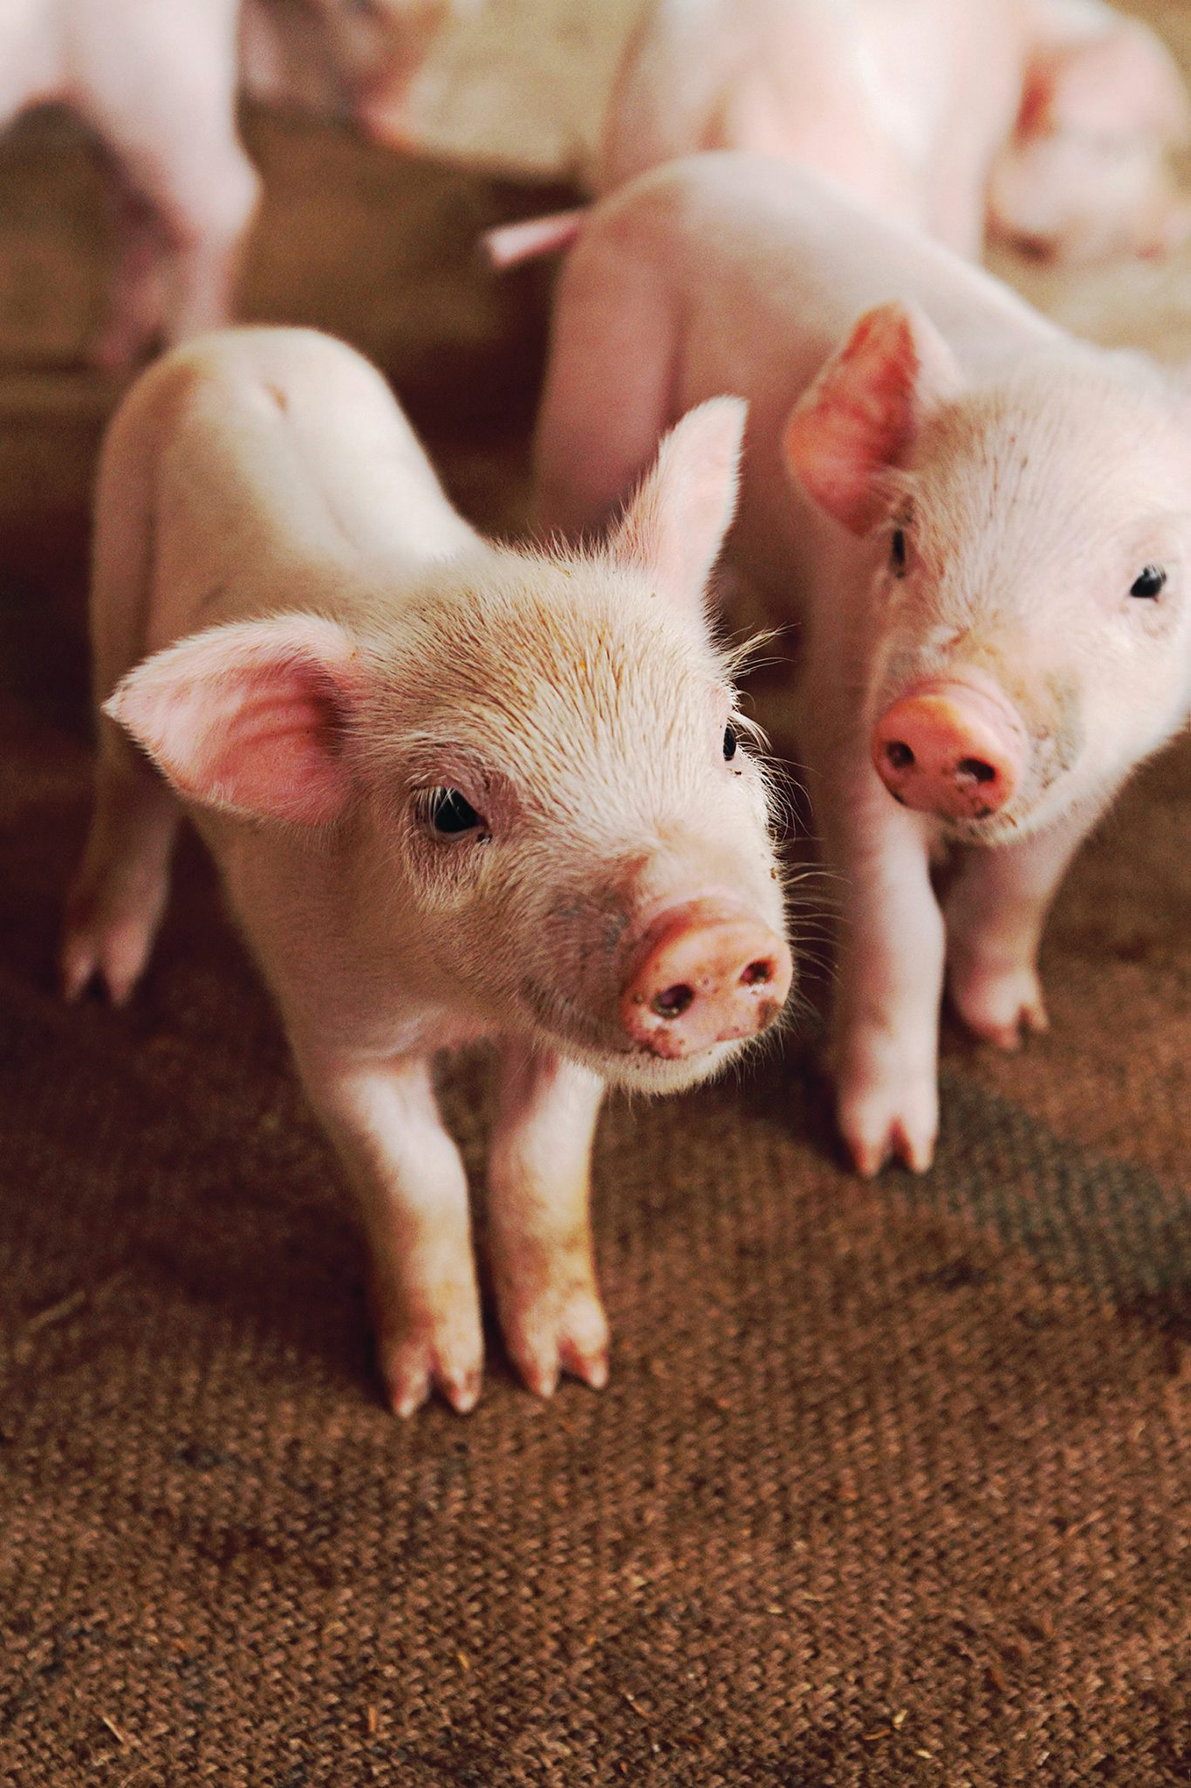
Reasons for antibiotic use:
Increased feed efficiency
Increased growth promotion
Treat and prevent disease

Slide 5
Animal Drug Residue Concerns
Consumer health risk
Consumer preference
Production loss for the producer (lost milk product, lost animal)
Legal action against the producer (violative illegal residues)
Notes:
The concerns of use are the number of hogs sent to market with illegal amounts of drug residue in the tissue.

Slide 6
Industry Action:
The U.S. National Residue Program administered by the USDA and Food Safety and Inspection Service is a program that identifies, ranks and tests for chemical contaminants in meat, poultry and egg products.
Residue monitoring has been stepped up significantly to help monitor more closely the increased incidence of illegal residues found at slaughter.
Agencies such as the FDA work to remove harmful substances from the market. (Example: Carbadox)
Notes:
http://www.fda.gov/NewsEvents/Newsroom/PressAnnouncements/ucm494934.htm

Slide 7
What are the consequences of
Illegal Drug Residue?
Producers found guilty of illegal drug residue may face the following:
financial penalties
criminal penalties
refusal at the sale barn and packing facilities
negative public perception
Notes:
According to Codex Alimentarius Commission Procedural Manual, Fourteenth Edition (2004), Animal Drug Residues are defined as:
“Residues of veterinary drugs include the parent compounds and/or their metabolites in any edible portion of the animal product, and include residues of associated impurities of the veterinary drug concerned.”

Slide 8
Commonly used drugs:
Sulfa drugs or sulfonamides
Tetracyclines
Pleuromutilin (Tiamulin)
Macrolide (Tylosin)
Lincosamides (Lincomycin)

Slide 9
Sulfonamides
Sulfa residues have been found in the livers of slaughtered swine. Extensive testing and research has demonstrated, sulfa residue is not due to illegal drug use or improper withdrawal time. It is the result of cross-contamination between medicated and non-medicated feeds. Therefore, a high importance is placed on the flushing and cleaning methods of producers that mix their own feed.

Slide 10
Residue Prevention Checklist
Establish a Veterinary Client Patient Relationship
Adopt a Quality Assurance Program
Supply fresh water
Clean feeders
Clean manure and bedding
Clean equipment to prevent cross-contamination
Practice proper injection site techniques
Identify individually treated animals
Keep good records
Practice proper feed mixing practices
  Read and follow label instructions
  Use proper dosage
  Follow established withdrawal times
Avoid using feeders for both medicated and non-medicated feed whenever possible
Do not mix hogs receiving sulfa with market animals
Prevent delivery errors
  Clearly mark medicated and non-medicated bins and feeders

Slide 11
Things to consider: when choosing a medication
Bioavailability
Dosage
Pig feeding behavior
Notes:
When choosing a medication, both cost and the administration route are important factors to consider. Related to the concentration of the drug, the three factors below must be considered. If any of these three factors is not addressed, the concentration of the drug when delivered (in feed or water) are unlikely to meet the MIC for the targeted pathogen and be wasted drug.
https://www.aasv.org/shap/issues/v6n5/v6n5p189.pdf

Slide 12
Veterinary-Client-Patient Relationship
VCPR is an ongoing relationship with an accredited veterinarian.
It helps to ensure the veterinarian has assumed responsibility regarding the health of the animal.
Notes:
It is important for a producer to have an ongoing relationship with an accredited veterinarian. This helps to ensure the veterinarian has assumed responsibility for making medical judgements regarding the health of the animal and need for medical treatment.

Slide 13
Record Keeping
Records should include: treatment date, animal identification, name of employee administering the drug, drug administered, weight of animal, route of administration, disease being treated, withdrawal time and the first date the animal can be sent to slaughter.
Records should be kept at least two years.
Notes:
Should your operation get cited for a residue violation and you believe it’s a case of mistaken identity, good records are your best evidence that the animal in question does not belong to you.

Slide 14
Avoid Extra-Label Drug Use
Extra-label drug use (ELDU) is the use of an animal drug in a manner that is different from label instructions in regard to:
the disease being treated
route of administration of the drug
dosage of the drug
the recommended treatment regimen
It is important to follow all labeled directions and withdrawal dates.
Notes:
Withdrawal time is the amount of time required for a drug or chemical concentration to fall below the Tolerance Level established in a specific target animal tissue. It is determined experimentally and dependent upon drug, dose, formulation, route of administration, species, target issue and disease/management factors. The time required for drug concentrations in all food animal tissues or products are below tolerance. Considerations include aesthetic considerations, risks perceived by the public, sensitive populations and issues, international relations and trade barriers
Extra-label drug use is a higher dose than the label, a different route or species than the label or a different disease that is being treated than indicated on the label.

Slide 15
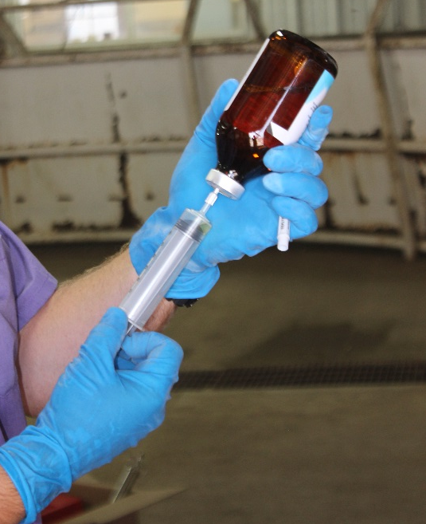
Injection Technique
Things to consider when giving an injection include:
Administer the shot in the neck
Inject subcutaneously when possible
Make sure the injection site is clean
Use the proper size needle based on: the location, route of administration, volume of injection and the thickness of the fluid
Do NOT use bent needles

Slide 16
What is a Veterinary Feed Directive (VFD)?
And
What is their part in drug residue avoidance?

Slide 17
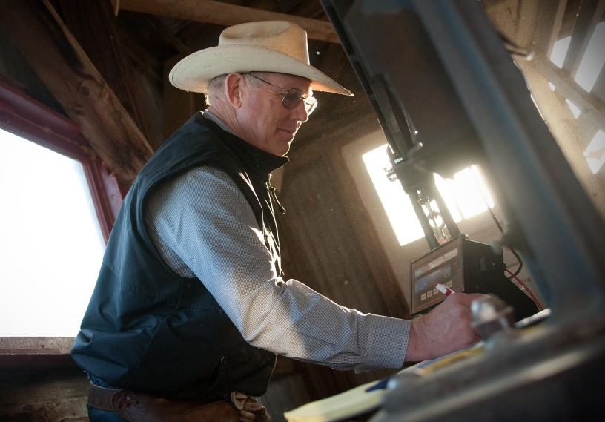
What is a VFD?
A VFD is a written (nonverbal) statement issued by a licensed veterinarian that authorizes the use of a VFD drug in or on animal feed.

Slide 18
How are VFDs related to drug residue?
VFDs are part of the FDAs strategy to reduce the amount of drug residue in the meat. It is an action to promote the judicious use of medically important antimicrobial drugs in food animals.

Slide 19
Summary
Failing to practice good residue avoidance can lead to financial penalties and a poor public perception of the swine industry. Good management practices, along with following withdrawal times on VFDs, help to reduce residues at the packing facilities. Remembering the prevention checklist and tips like having a good VCPR, practicing accurate record keeping, avoiding ELDU, and having proper injection site techniques result in better meat quality.

Slide 20
Contact Us
Kansas Department of Agriculture
(785) 564-6601 or (785) 564-6778
agriculture.ks.gov/animalhealth
vfdinfo.org

