Slide 1
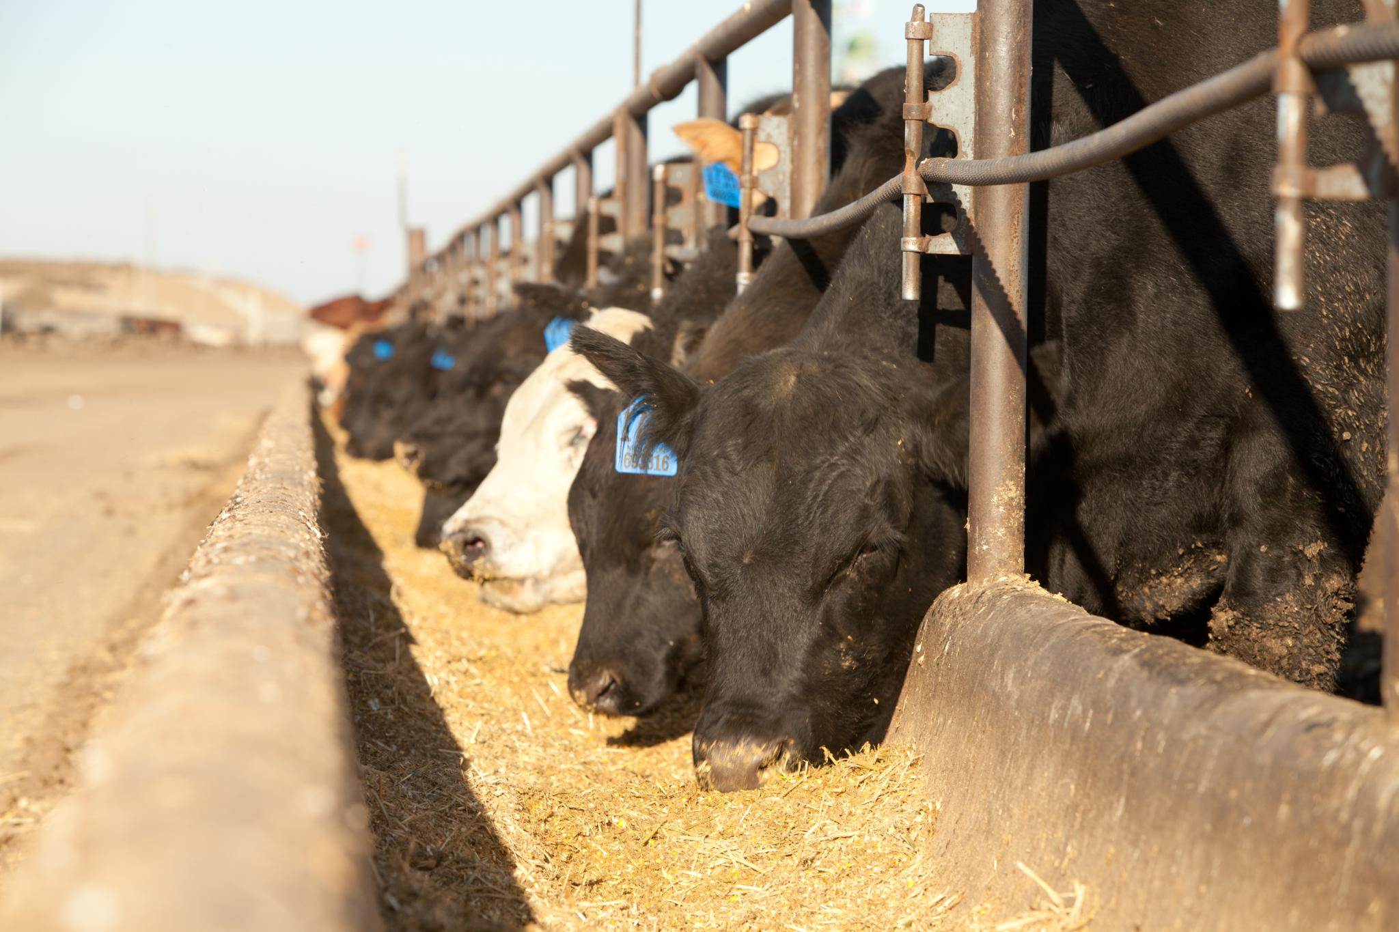
Drug Residue Avoidance in Feedlot Cattle

Slide 2
Feedlot Segment
The beef industry is committed to producing a safe, wholesome and affordable beef product of the highest quality.
It is through the dedication and commitment of all who participate in the food supply chain to ensure animals are healthy and free from disease.
Antibiotics should be used appropriately to prevent residues from occurring in cattle sent to market.

Slide 3
Animal Drug Residue Concerns
Consumer health risk
Consumer preference
Production loss for the producer (lost milk product, lost animal)
Legal action against the producer (violative illegal residues)

Slide 4
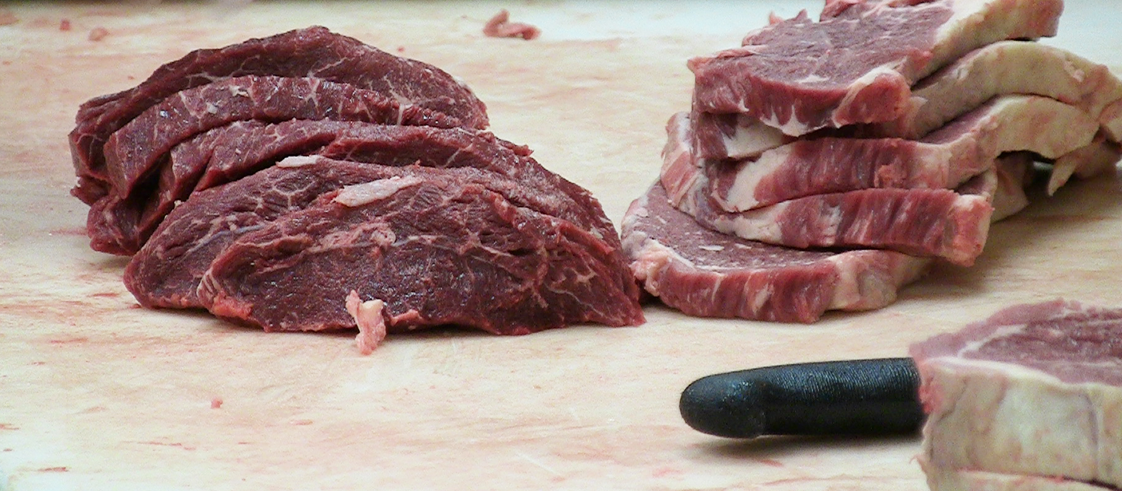
Drug Residue vs. Illegal Drug Residue
“Drug residue” refers to the presence of veterinary drugs or dewormers in meat.
“Illegal drug residue” is any drug found above the allowable range in an animal sent to slaughter.
Notes:
According to Codex Alimentarius Commission Procedural Manual, Fourteenth Edition (2004), Animal Drug Residues are defined as:
“Residues of veterinary drugs include the parent compounds and/or their metabolites in any edible portion of the animal product, and include residues of associated impurities of the veterinary drug concerned.”

Slide 5
Drug Residue
Residues found in beef above the tolerable levels most often occur due to the following:
uninformed drug use by small segments of the animal industry
failure to adhere to proper withdrawal regulations
extra-label use of drugs
lack of animal identification or traceability
There are regulations to ensure that no residues beyond the prescribed tolerance levels enter the food supply chain.
Notes:
Tolerable level: the maximum permissible residue level which may be present in tissues or food animal products

Slide 6
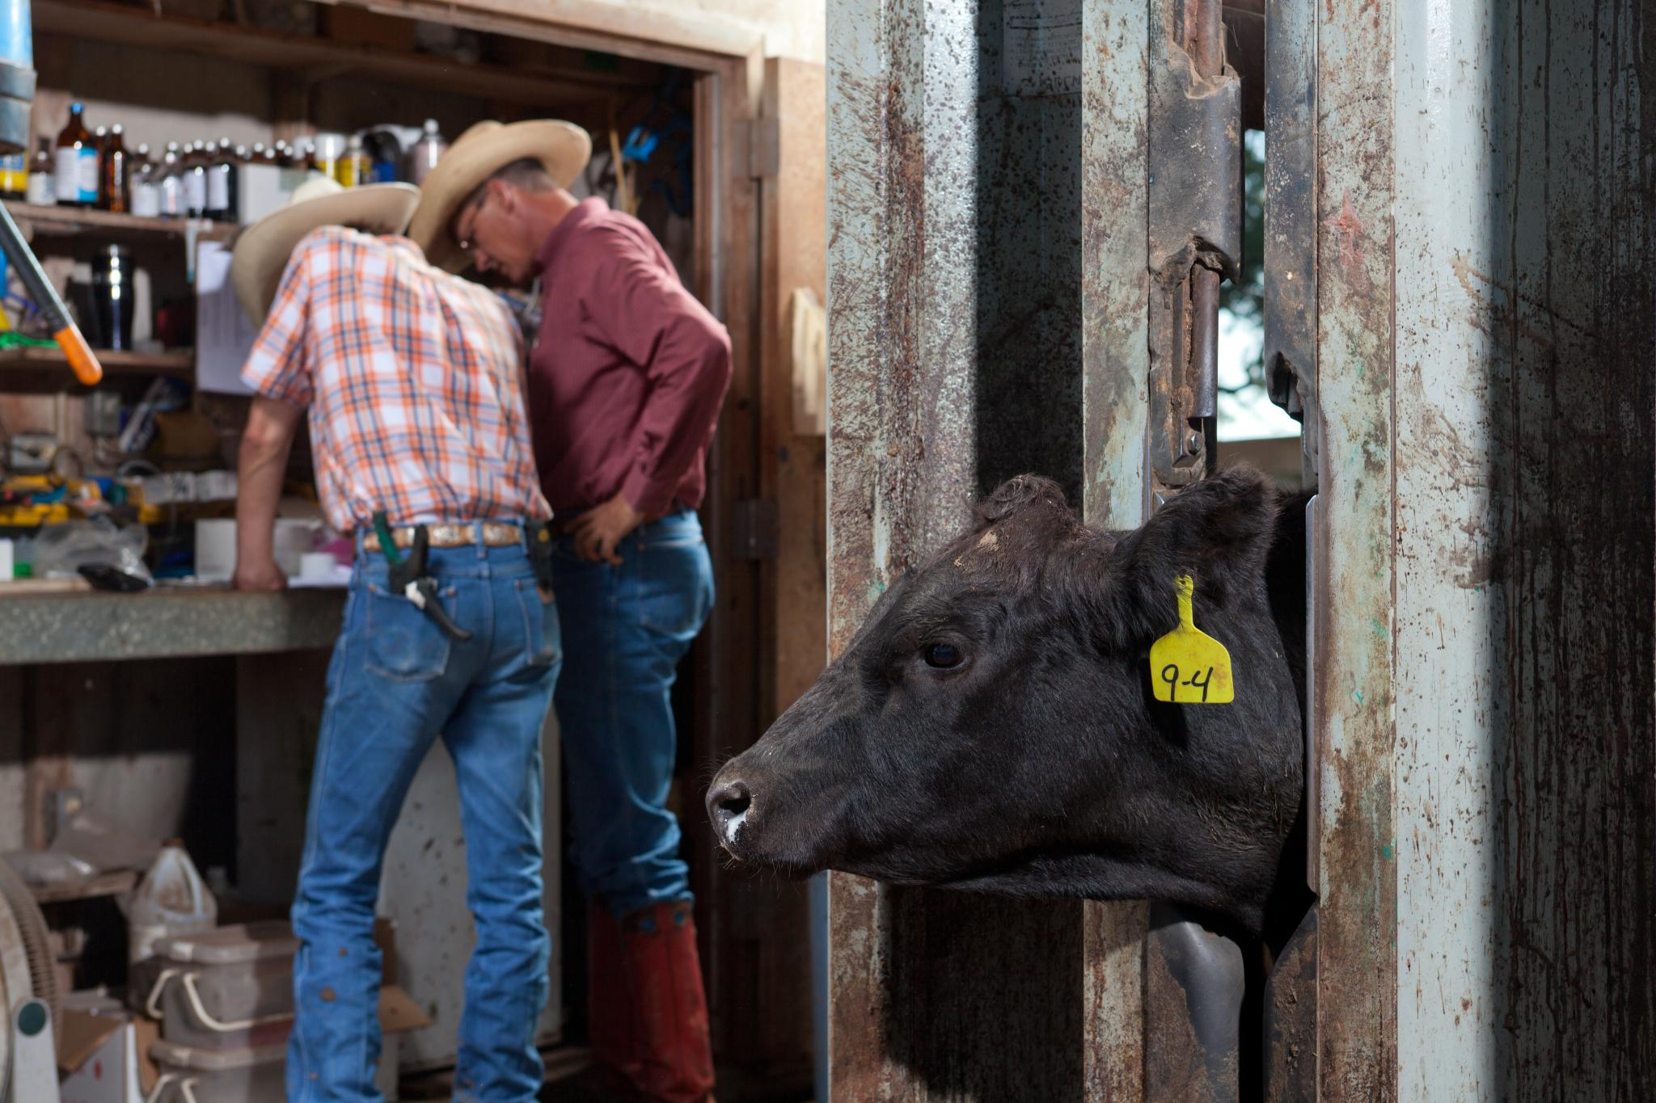
What are the consequences of
Illegal Drug Residue?
Producers who are found guilty of illegal drug residue may face the following:
financial penalties
criminal penalties
refusal at the sale barn and packing facilities
negative public perception

Slide 7
Human Health Risk Issues
In the beef industry, contaminated meat is a major concern for human health. Any adulterated product may result in the following:
  Drug residue allergies
  Development of antibiotic resistant bacteria
  Potential for cancer, reproductive or developmental effects
  Hormone-related risks
Notes:
A major issue of drug use in food animals as well as over-use of antibiotics in humans is antibiotic-resistant bacteria isolated from meat.
A general hypothesis is that the greater amount of a drug used, the more likely bacteria would develop resistance to it.

Slide 8
Residue Testing and Monitoring
Residues in fresh meat are monitored by the Food Safety Inspection Service through the National Residue Program (NRP).
The NRP helps prevent the entry of animals containing violative residues of pesticides, drugs or potentially hazardous chemicals into the food chain through monitoring and enforcement.
Random samples are tested for monitoring the national residue incidence.
Notes:
Target tissues tested (milk, kidneys often tested at slaughter)
STOP (swab test on premises)
FAST (fast antimicrobial screen test)
SOS (sulfa-on-site)
CHARM II; SNAP (milk residues)
Lab tests (HPLC/GC/Mass Spectrometry)

Slide 9
Feedlot Drug Use
Commonly used antimicrobials in feedlot cattle include: Penicillin, tetracyclines, trimethoprim-sulfonamides, erythromycin and others
Feedlot cattle are typically treated for common diseases during the early part of the feeding period and therefore have 75 to 200 days to eliminate the drug from the body.

Slide 10
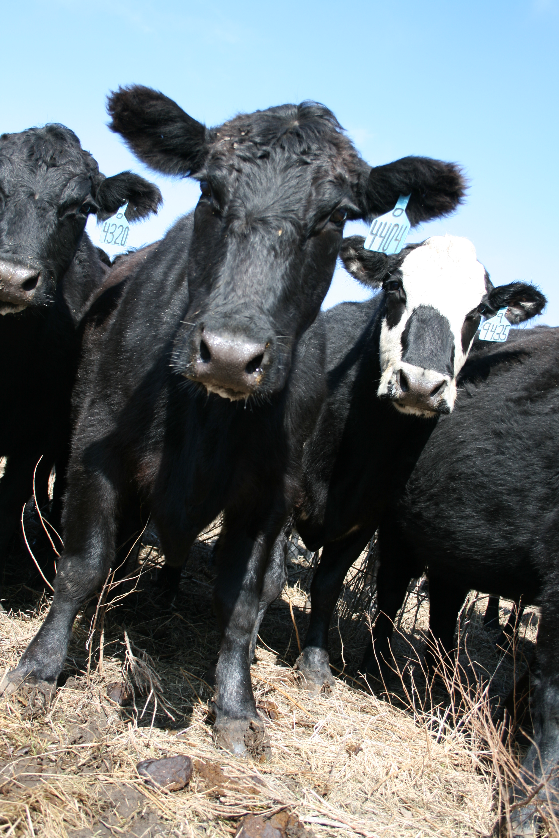
Prevention Practices
Veterinary-Client-Patient Relationship
Good Record Keeping
Avoid Extra-Label Drug Use
Proper Injection Techniques

Slide 11
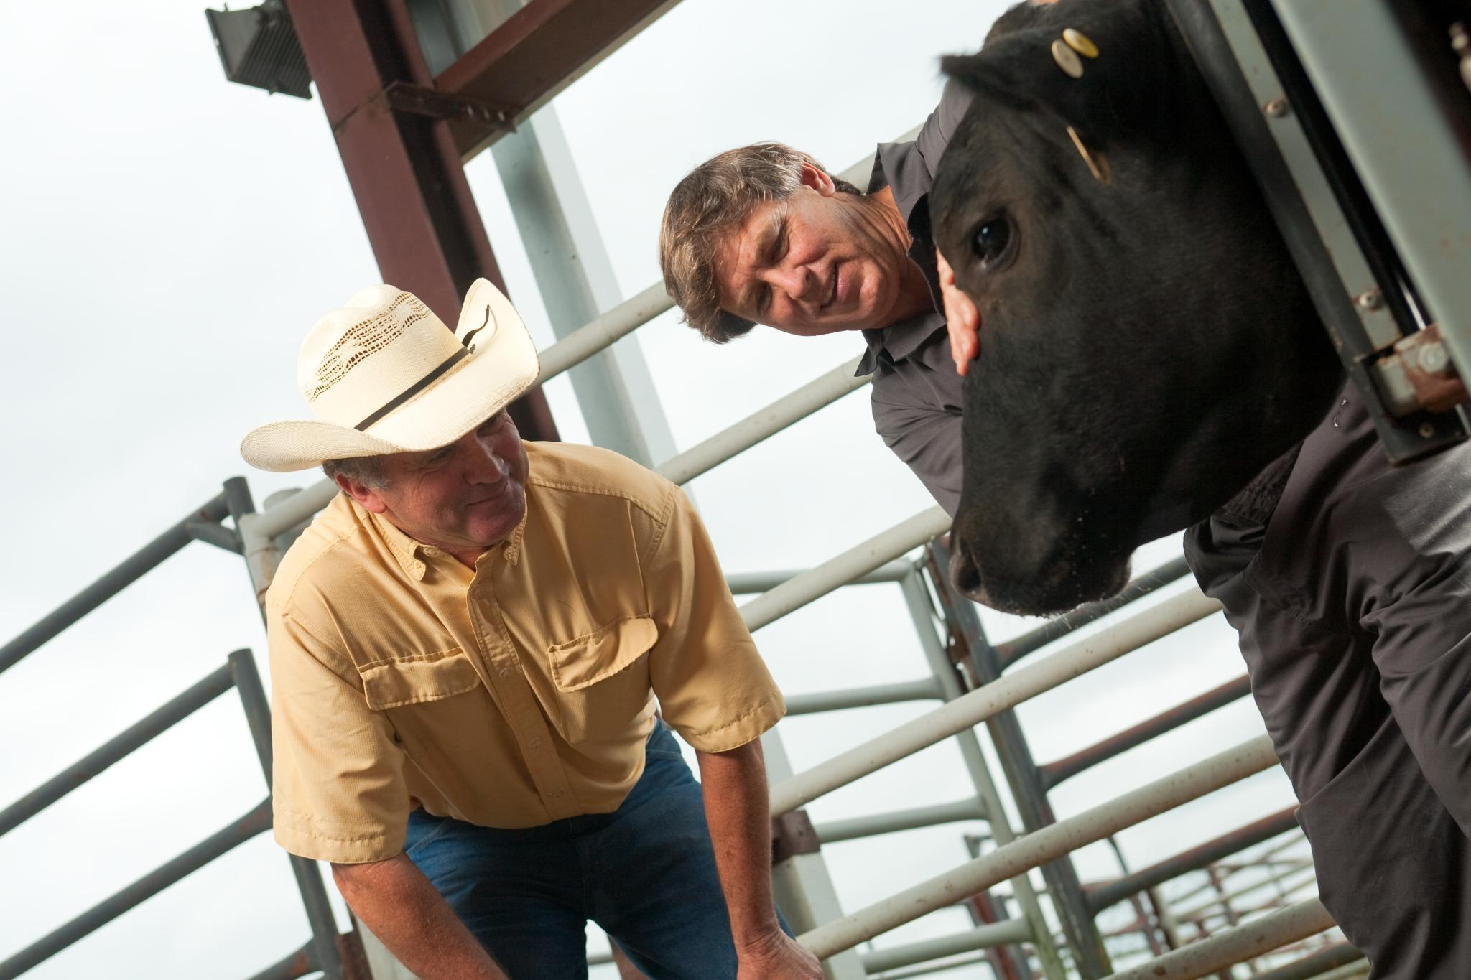
Veterinary-Client-Patient Relationship
It is important for a producer to have an ongoing relationship with an accredited veterinarian. This helps to ensure the veterinarian has assumed responsibility for making medical judgements regarding the health of the animal and need for medical treatment.

Slide 12
Record Keeping
Records should include: treatment date, animal identification, name of employee administering the drug, drug administered, weight of animal, route of administration, disease being treated, withdrawal time and the first date the animal can be sent to slaughter.
Records should be kept at least two years.
Notes:
Should your operation get cited for a residue violation and you believe it’s a case of mistaken identity, good records are your best evidence that the animal in question does not belong to you.

Slide 13
Avoid Extra-Label Drug Use
Extra-label drug use (ELDU) is the use of an animal drug in a manner that is different from label instructions in regard to:
the disease being treated
route of administration of the drug
dosage of the drug
the recommended treatment regimen
It is important to follow all labeled directions and withdrawal dates.
Notes:
Withdrawal time is the amount of time required for a drug or chemical concentration to fall below the Tolerance Level established in a specific target animal tissue. It is determined experimentally and dependent upon drug, dose, formulation, route of administration, species, target issue and disease/management factors. The time required for drug concentrations in all food animal tissues or products are below tolerance. Considerations include aesthetic considerations, risks perceived by the public, sensitive populations and issues, international relations and trade barriers
Extra-label drug use is a higher dose than the label, a different route or species than the label or a different disease that is being treated than indicated on the label.

Slide 14
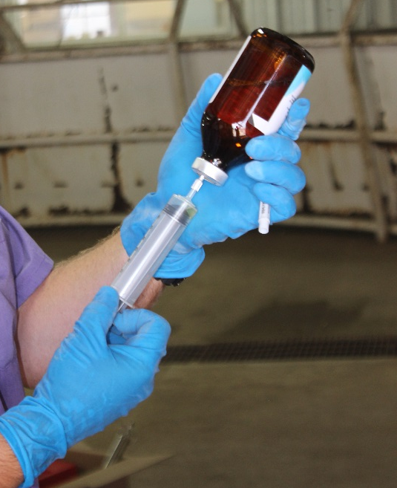
Injection Technique
Things to consider when giving an injection include:
Administer the shot in the neck
Inject subcutaneously when possible
Make sure the injection site is clean
Use the proper size needle based on: the location, route of administration, volume of injection and the thickness of the fluid
Do NOT use bent needles

Slide 15
What is a Veterinary Feed Directive (VFD)?
And
What is their part in drug residue avoidance?

Slide 16

What is a VFD?
A VFD is a written (nonverbal) statement issued by a licensed veterinarian that authorizes the use of a VFD drug in or on animal feed.

Slide 17
How are VFDs related to drug residue?
VFDs are part of the FDAs strategy to reduce the amount of drug residue in meat. It is an action to promote the judicious use of medically important antimicrobial drugs in food animals.

Slide 18
Summary
Failing to practice good residue avoidance can lead to financial penalties and a poor public perception on the beef industry. Good management practices, along with following withdrawal times on VFDs, help to reduce residues at the packing facilities.
Remembering the prevention checklist and tips like having a good VCPR, practicing accurate record keeping, avoiding ELDU, and having proper injection site techniques result in better meat quality.

Slide 19
Contact Us
Kansas Department of Agriculture
(785) 564-6601 or (785) 564-6778
agriculture.ks.gov/animalhealth
vfdinfo.org

